Slide 1
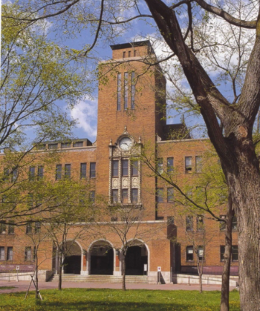
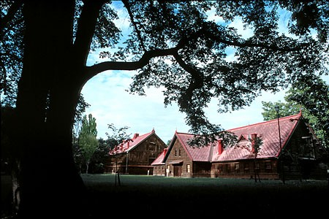
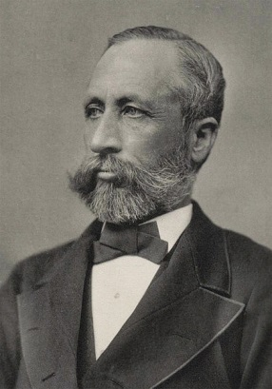
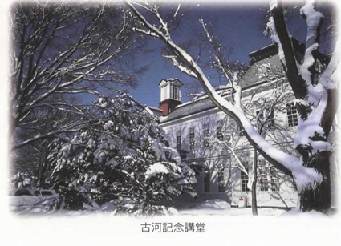
School of Agriculture, Hokkaido University:
150 Years of History and Looking to the Future
Hokkaido University
Research Faculty of Agriculture / Graduate School of Agriculture
/ School of Agriculture
1

Slide 2
Contents
1. History and Philosophy
2. Organization and Personnel
3. Studying at the School of Agriculture
4. Studying at the Graduate School of Agriculture
5. Facilities and Environment
6. Appendix
P. 3
P. 13
P. 22
P. 40
P. 50
P. 65

Slide 3
1. History and Philosophy

Slide 4
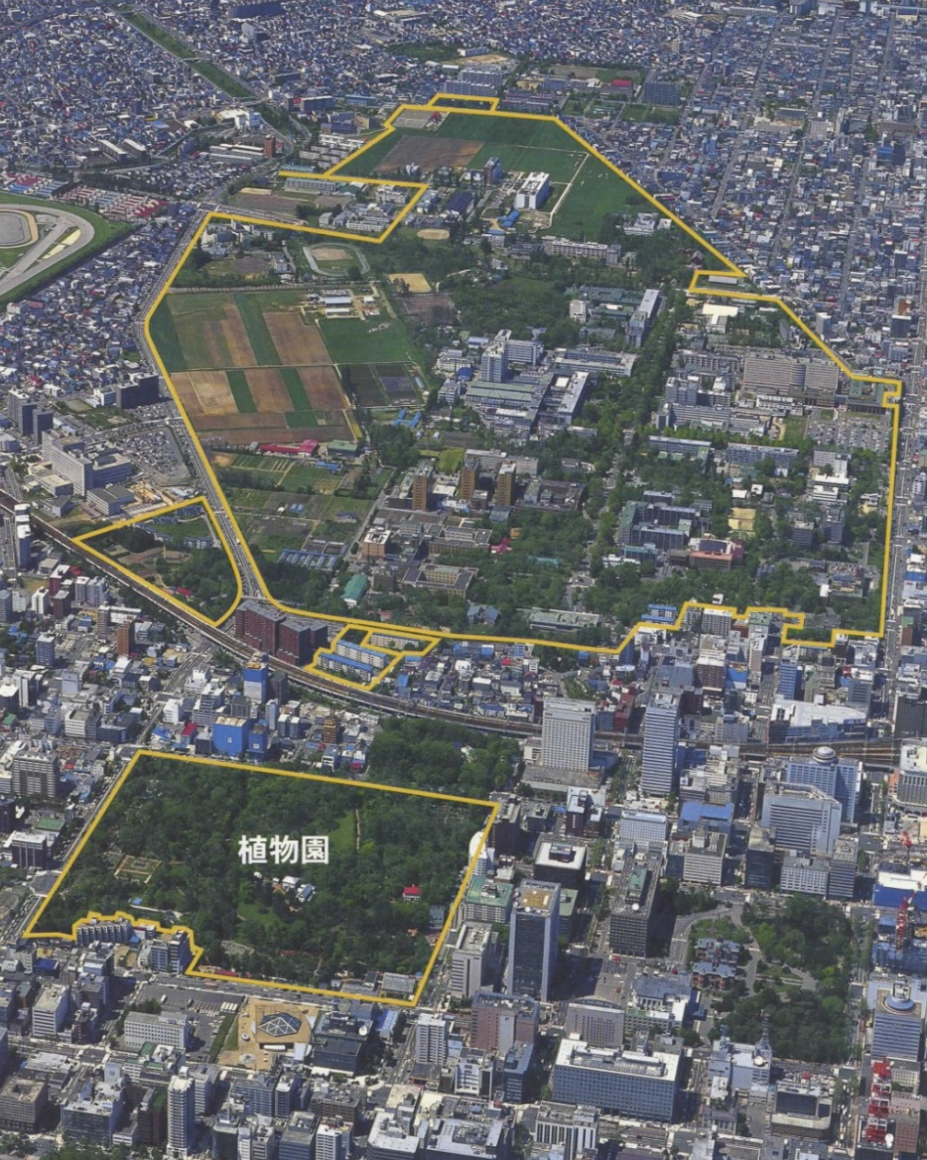
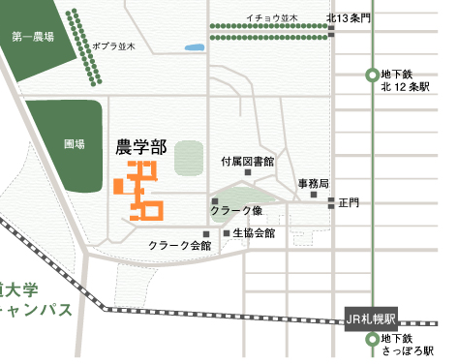
School of Agriculture,
Hokkaido University
University Farm
Seedling Field

Slide 5
History of School of Agriculture, Hokkaido University
1869 Hokkaido Development Commission (HDC) established
1871 Horace Capron visits Japan and recommends establishing an agricultural
school in Hokkaido
1872 Temporary HDC school opens in Shiba, Tokyo
1875 HDC school renamed Sapporo School
1876 Sapporo Agricultural College established
The first institution in Japan to confer bachelor’s degrees
1907 Integrated into Tohoku Imperial University as its Agricultural College
1918 Became the Agricultural College of Hokkaido Imperial University
1919 Faculties of Agriculture, Medicine, Engineering, and Science
established at Hokkaido Imperial University
1947 Renamed School of Agriculture, Hokkaido University
– Faculties of Fisheries (1949) and Veterinary Medicine (1952) became independent
1953 Graduate School of Agriculture established
1992 School of Agriculture reorganized into 7 departments
2006 Graduate school reorganized into
the Graduate School and Research Faculty of Agriculture
2019 Graduate school reorganized into one division with 3 courses

Slide 6
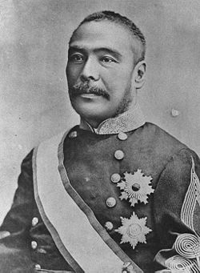
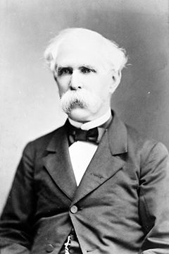
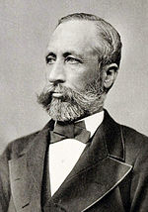
Founders of Sapporo Agricultural College
Horace Capron 1804-1885
HDC advisor (1871-1875)
US Commissioner of Agriculture
W. S. Clark
1826-1886
Assistant director
(8 months)
President of Massachusetts Agricultural College
Kiyotaka Kuroda
1840-1900
Hokkaido Development Commissioner
Later became Prime Minister

Slide 7
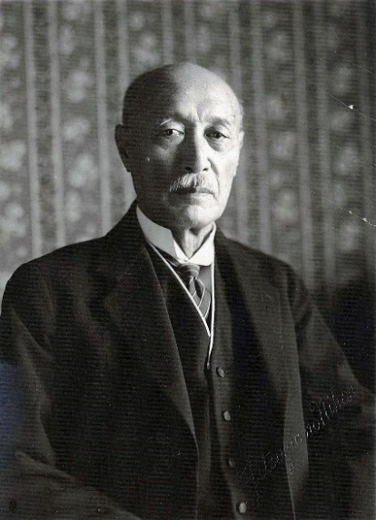
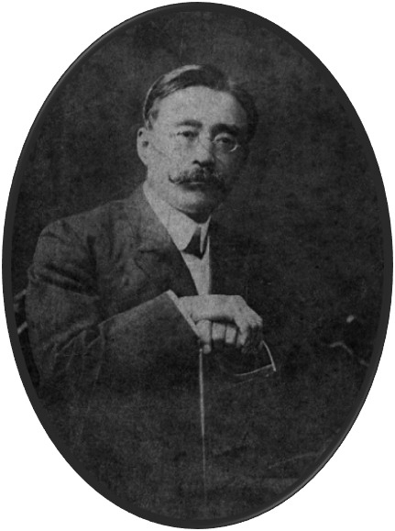
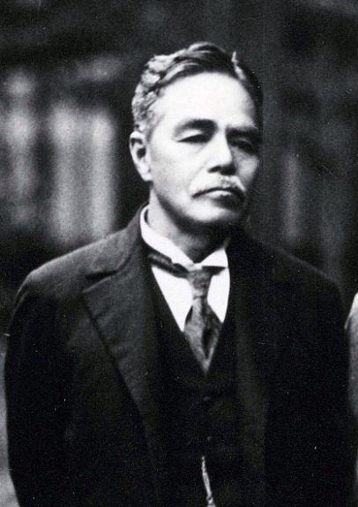
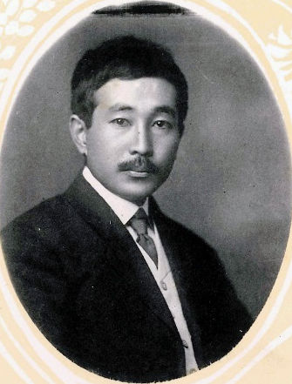
Prominent Figures of Sapporo Agricultural College
Switch
Switch
Switch
Switch
Inazo Nitobe
1862-1933
Member of the second graduating class
Professor at Hokkaido, Kyoto, Tokyo, and Tokyo Women’s Universities
League of Nations Deputy Secretary-General
Author of Bushido
Shosuke Sato
1856-1939
Member of the first graduating class
Father of Hokkaido University
Director/President
(1894-1930)
Kanzo Uchimura
1861-1930
Member of the second graduating class
Thinker
Takeo Arishima
1878-1923
Member of the 19th class
Novelist
Professor

Slide 8
Principles based on the university's philosophy
Four principles cultivated over 150 years of history
Frontier Spirit
Global Perspective
All-round Education
Practical Learning

Slide 9
Issues for Agriculture in the 21st Century
Food, Water, Environment, Energy: Can Humanity Survive?
Global Population: 8.2 billion --> 9.8 billion in 2050
Global Arable Land: Remains at around 1.4 billion ha
Global Grain Production: 2.6 billion tons – approaching production limits
      (rice, wheat, corn)
Projected Ending Stocks-to-Use Ratio for 2025/2026: 29.8%
(safe stock level: 17-18%)

Slide 10
Issues for Agriculture in the 21st Century
Food, Water, Environment, Energy: Can Humanity Survive?
Japan’s Food Self-Sufficiency Rate: 38% (lowest among developed countries)
Global Climate Change and Water Scarcity
Energy Crisis: Biofuels (Energy vs. Food)
Risks Across Society: failing administrative and financial systems, food crises, economic and social instability, deterioration of public health and sanitation, infectious diseases, depletion of water and energy resources, large-scale natural disasters, radioactive contamination, etc.

Slide 11
The School of Agriculture Today
Research Faculty of Agriculture
(Faculty)
An Urgent Challenge for Agricultural Science:
"Establish sustainable food production technologies to feed the rapidly growing global population"
Principle of Agricultural Science:
A Shared Vision
“Contributing to the sustainable prosperity of humanity by establishing the foundations for human survival based on the biosphere.”
School of Agriculture
(Undergraduate Students)
Graduate School of Agriculture
(Graduate students)
Notes:
What ideas do you have about agricultural studies?
The ultimate mission demanded of the school of agriculture now is to "establish sustainable food production technology to nourish the rapidly increasing global population." Based on the principle of the School of Agriculture, "contributing to sustainable human prosperity through the establishment of infrastructure for survival based on the biosphere," we pursue education and research in order to respond to these pressing issues. The School of Agriculture is a four-year undergraduate college. You will be a part of this institution if you join us. About 70% of our undergraduates go on to graduate school. This includes the master's course and the doctoral course. The Research Faculty of Agriculture is the teachers' institution. These are the three levels of our faculty.

Slide 12
The School of Agriculture Today
Principles of Agricultural Science:
  Contributing to the sustainable prosperity of humanity by establishing the foundations for human survival based on the biosphere
Urgent Challenge:
  Establishing sustainable food production technologies to feed the rapidly growing global population
Four Key Research Fields to Address These Challenges
Food Production
Environment
Food Distribution/
Utilization
Basic Bioscience
• These four research fields are closely interconnected.
Only by bringing together their strengths can we address
the challenges described above.
• Thus, agricultural science is not limited to agricultural
production but encompasses a wide range of related fields.
Notes:
What ideas do you have about agricultural studies?
The ultimate mission demanded of the school of agriculture now is to "establish sustainable food production technology to nourish the rapidly increasing global population." Based on the principle of the School of Agriculture, "contributing to sustainable human prosperity through the establishment of infrastructure for survival based on the biosphere," we pursue education and research in order to respond to these pressing issues.

Slide 13
2. Organization and Personnel

Slide 14
Changes in the School of Agriculture Organizational Structure:
Establishment of Majors (from 1953)
8 divisions
Graduate School of Agriculture
Division of Agronomy
Division of Agricultural Economics
Division of Agricultural Biology
Division of Agricultural Chemistry
Division of Forestry
Division of Forest Products
Division of Animal Science
Division of Agricultural Engineering
8 departments
School of Agriculture
Department of Agronomy
Department of Agricultural Economics
Department of Agricultural Biology
Department of Agricultural Chemistry
Department of Forestry
Department of Forest Products
Department of Animal Science
Department of Agricultural Engineering

Slide 15
Changes in the School of Agriculture Organizational Structure:
Establishment of Research Faculty and Graduate School (from 2006)
3 divisions
Research Faculty of Agriculture
Division of Bioresources and Product Science
Division of Environmental Resources
Division of Applied Bioscience
4 divisions
Graduate School of Agriculture
Division of Bio-Systems Sustainability
Division of Agrobiology
Division of Environmental Resources
Division of Applied Bioscience
7 departments
School of Agriculture
Department of Agrobiology and Bioresources
Department of Agricultural Economics
Department of Applied Bioscience
Department of Bioscience and Chemistry
Department of Forest Science
Department of Animal Science
Department of Agricultural Engineering

Slide 16
Changes in the School of Agriculture Organizational Structure:
Establishment of a New Research Division (2011; renamed the Division of Research Innovation and Cooperation in 2013)
4 divisions
Research Faculty of Agriculture
Division of Research Innovation and Cooperation
Division of Bioresources and Product Science
Division of Environmental Resources
Division of Applied Bioscience
4 divisions
Graduate School of Agriculture
Division of Bio-Systems Sustainability
Division of Agrobiology and Bioresources
Division of Environmental Resources
Division of Applied Bioscience
7 departments
School of Agriculture
Department of Agrobiology and Bioresources
Department of Agricultural Economics
Department of Applied Bioscience
Department of Bioscience and Chemistry
Department of Forest Science
Department of Animal Science
Department of Agricultural Engineering
Notes:
The Research Faculty of Agriculture was originally composed of the Divisions of the three divisions of Bioresources and Product Science, Environmental Resources, and Applied Bioscience, but in April 2011, the Division for Research Innovation and Streamlining was added as a platform to promote collaboration among diverse Japanese and international organizations as well as outreach regarding basic research area outcomes, revitalizing the Research Faculty further. Thereafter, in April 2013, this Division was expanded and reorganized into the Division for Research Innovation and Collaboration, creating four divisions over 17 fields.

Slide 17
Changes in the School of Agriculture Organizational Structure:
Problems (Only two faculty members in each lab and mismatch between research groups and departments)
4 divisions, 17 fields
Division of Bioresources and Product Science
Division of Environmental Resources
Division of Applied Bioscience
Research Faculty of Agriculture
Division of Research Innovation and Cooperation
Field
Field
Field
Field
Field
Field
Each division is composed of fields (various research groups)
4 divisions
Graduate School of Agriculture
Division of Bio-Systems Sustainability
Division of Agrobiology and Bioresources
Division of Environmental Resources
Division of Applied Bioscience
7 departments
School of Agriculture
Department of Agrobiology and Bioresources
Department of Agricultural Economics
Department of Applied Bioscience
Department of Bioscience and Chemistry
Department of Forest Science
Department of Animal Science
Department of Bioresource and Environmental Engineering
The four divisions and 17 fields in the Research Faculty of Agriculture were based on academic fields and did not correspond to the seven departments
The reduction in faculty numbers made it difficult to assign sufficient faculty to each laboratory, increasing faculty burdens and affecting student guidance.
The unbalanced three-school structure made staffing an issue and contributed to
limited faculty turnover and an aging faculty.
Notes:
However, the four divisions and 17 fields in the Research Faculty of Agriculture were based on academic fields, not in response to the seven undergraduate departments. The organization has become extremely complicated along with the four graduate majors, the unbalanced three-school structure meant that staffing and consistent education were problems. Reduced numbers (targeted faculty reduction) meant that faculty could not be suitably assigned to labs; increasing faculty burdens along with diversification of duties made it difficult to assign educational tasks fairly and efficiently in undergraduate and graduate education and research. As well, targeted staff reduction meant that staffing stagnated and faculty average age increased. It was also important to clarify the system of responsibility for instruction from the perspective of care for students' increasingly complex and confused mental hygiene.

Slide 18
Changes in the School of Agriculture Organizational Structure:
Reorganization of Research Faculty (from 2015)
2 divisions, 9 fields
Division of Fundamental Agriscience Research
Division of Research Innovation and Cooperation
Research Faculty of Agriculture
Research Group of Agrobiology and Bioresources
Research Group of Agricultural Economics
Research Group of Applied Bioscience
Research Group of Bioscience and Chemistry
Research Group of Forest Science
Research Group of Animal Science
Research Group of Bioscience and Environmental Engineering
Graduate School of Agriculture
4 divisions
Division of Bio-Systems Sustainability
Division of Agrobiology and Bioresources
Division of Environmental Resources
Division of Applied Bioscience
7 departments
School of Agriculture
Department of Agrobiology and Bioresources
Department of Agricultural Economics
Department of Applied Bioscience
Department of Bioscience and Chemistry
Department of Forest Science
Department of Animal Science
Department of Bioresource and Environmental Engineering
Reducing the number of laboratories enabled the assignment of three faculty members to each laboratory.
Research groups were aligned with undergraduate departments to resolve the organizational mismatch.
Notes:
Here, in 2015, the Research Faculty of Agriculture was reorganized into a new Division of Fundamental Agriscience Research, composed of the seven fields in the seven undergraduate departments, and the existing Division of Research Innovation and Cooperation. The Division of Fundamental Agriscience Research includes Research Groups on Agrobiology and Bioresources, Applied Bioscience, Bioscience and Chemistry, Forest Science, Animal Science, Bioresource and Agricultural Engineering, and Agricultural Economics, corresponding to the seven departments, while the Division of Research Innovation and Cooperation has the existing Cooperative and Integrated Research Groups. In this way, by reorganizing the Research Faculty from the current four divisions and 17 fields to two divisions and nine fields, it has become possible to develop high-quality education and research while responding to the needs of the times, handling educational system reform flexibly, and firmly observing the principles of education and research.

Slide 19
Changes in the School of Agriculture Organizational Structure:
Reorganization of the Graduate School (2019 on)
2 divisions, 9 fields
Division of Fundamental Agriscience Research
Research Faculty of Agriculture
Division of Research Innovation and Cooperation
Research Group of Agrobiology and Bioresources
Research Group of Agricultural Economics
Research Group of Applied Bioscience
Research Group of Bioscience and Chemistry
Research Group of Forest Science
Research Group of Animal Science
Research Group of Bioscience and Environmental Engineering
Graduate School of Agriculture
Division of Agriculture
1 division
Frontiers in Production Sciences
Frontiers in Biosciences
Frontiers in Environmental Sciences
School of Agriculture
Department of Agrobiology and Bioresources
Department of Agricultural Economics
Department of Applied Bioscience
Department of Bioscience and Chemistry
Department of Forest Science
Department of Animal Science
Department of Bioresource and Environmental Engineering
7 departments
The Graduate School was reorganized from 4 divisions and 15 courses into 1 division and 3 courses.
Boundaries between the former divisions were removed, enabling education and research supervision across divisions.
Notes:
In April 2019, the existing "four major, 15 course" system was reorganized into one major and three courses, in order to respond to social needs, student needs, and existing Graduate School issues. The Graduate School itself replaced the existing majors, divided into three courses: Frontiers in Production Sciences, in Biosciences, and in Environmental Sciences.
By removing the borders between majors, this enabled interdisciplinary research and educational guidance, realizing the focused cultivation in the new major of four capacities: (1) the capacity to take a wide view and think with a broader perspective, (2) the capacity to act individually based on advanced specialist knowledge and ethics, (3) the capacity to engage, interact, and collaborate in multiple languages, and (4) the capacity to recognize the mission of agricultural studies and give back to society.

Slide 20
Lab Structure (as of April 2026)
Department of Agrobiology
and Bioresources
Department of Applied Bioscience
Department of Bioscience and Chemistry
Crop Science, Crop Physiology,
Plant Pathology,
Horticultural Science,
Ornamental Plants
and Landscape Architecture,
Animal Ecology,
Systematic Entomology,
Plant Genetics and Evolution,
Cell Biology and Manipulation, Pathogen-Plant Interactions,
Applied Plant Genomics
Plant Breeding, Genetic Engineering,
Applied Molecular Entomology,
Molecular Biology,
Molecular Enzymology,
Molecular and Ecological Chemistry,
Genome-Enabled Biochemistry,
Plant Nutrition, Soil Science,
Natural Product Chemistry,
Biochemistry, Microbial Physiology,
Nutritional Biochemistry,
Food Biochemistry,
Rhizosphere Control,
Applied Molecular Microbiology,
Environmental Biogeochemistry
Department of Bioresource
and Environmental Engineering
Department of Animal Science
Land and Water Management,
Ecological and Environmental Physics,
Soil Conservation, Vehicle Robotics,
Agricultural and Food Process Engineering,
Agricultural Bio-System Engineering,
Applied Bioproduction Engineering,
Terrestrial Ecosystem Modeling
Department of Forest Science
Animal Genetics and Reproduction,
Animal Production System,
Animal Function and Nutrition,
Cell and Tissue Biology,
Applied Food Science
Silviculture and Forest Ecology,
Forest Bioresource Technology,
Ecosystem Management,
Earth Surface Processes
and Land Management,
Forest Policy, Woody Plant Biology, Timber Engineering, Wood Chemistry
Department of Agricultural Economics
Industry Creation Research Group*
Agricultural and Environmental Policy, Farm Business Management,
Agricultural and Rural Development, Agricultural Cooperatives,
Food and Agricultural Marketing, Socio-Economics of Cooperatives,
Associations and Networks for Sustainable Rural Development,
Agricultural Resource Economics
Ecological Sensing and Processing,
K-IPM*
*Research organization established for joint research with private-sector organizations, etc.

Slide 21
Number of Faculty and Students (as of May 2026)
[Faculty]
48 professors, 35 associate professors, 9 lecturers,
26 assistant professors: 118 in total
[Students]
School of Agriculture: 663 (215 per class year x 3 years = 645)
Master’s Course: 347 (142 per class year x 2 years = 284)
Doctoral Course: 126 (36 per class year x 3 years = 108)
International Students: 1 undergraduate, 33 master‘s students,
38 doctoral students: 72 in total
International Students in the Special English Course:
19 master's students, 29 doctoral students: 48 in total
Notes:
From the 2019-2020 Overview of the Research Faculty of Agriculture/Graduate School of Agriculture/School of Agriculture

Slide 22
3. Studying at the School of Agriculture

Slide 23
Focused Research Areas (1)
○ Food Production
As the global population continues to grow, food shortages are becoming increasingly serious worldwide.
To address this urgent challenge, the School of Agriculture conducts research on efficient and environmentally sustainable food production.
○ Environment
As human activities have an increasing impact on the global environment, we are at a major turning point in how we use biological resources, soil, water resources, and energy.
Through cutting-edge research, we seek to address the fundamental challenge of reducing environmental impacts while maintaining a high quality of life.
Notes:
You have probably grasped the wide range of academic fields that awaits your diverse interests. Rather than studying your own interests alone, however, as noted above you should be thoroughly aware and proactive about how your research contributes to the achievement of objectives. This is an essential stance as you approach your experience as a student in the School of Agriculture. For example, what if you like insects? You cannot simply devote yourself to classifying insects and discovering new species. Instead, you should remain aware of the contributions your work can make to food production. For example, insect elimination can contribute to increased food production. This is what it means to study entomology in the School of Agriculture, in contrast to the School of Science.

Slide 24
Focused Research Areas (2)
○ Food Distribution and Utilization
Through research in the social sciences, we address a wide range of challenges, including diversifying food needs, stable food supply, and the development of distribution systems and markets.
○ Basic Bioscience
There is still much we do not know about the capabilities of organisms.
With the development of biological resources in mind, the School of Agriculture uses biotechnology to unravel the mysteries of life while exploring practical applications of these biological capabilities.
Our research aims not only to harness the inherent capabilities of organisms but also to develop technologies that can provide them with new functions.
This also includes exploring the relationship between food and health.
Notes:
You have probably grasped the wide range of academic fields that awaits your diverse interests. Rather than studying your own interests alone, however, as noted above you should be thoroughly aware and proactive about how your research contributes to the achievement of objectives. This is an essential stance as you approach your experience as a student in the School of Agriculture. For example, what if you like insects? You cannot simply devote yourself to classifying insects and discovering new species. Instead, you should remain aware of the contributions your work can make to food production. For example, insect elimination can contribute to increased food production. This is what it means to study entomology in the School of Agriculture, in contrast to the School of Science.

Slide 25
Globalization of Education
University-wide Study Abroad Programs
  Short-Term Overseas Language Training Programs (Summer and Spring Programs)
  Student Exchange Program (study abroad at partner universities)
  Hokkaido Summer Institute
  Overseas Learning Satellite
Others
  Cotutelle Program
  Double Degree Program
Available Scholarships
Hokkaido University Clark Study Abroad Grant
JASSO Study Abroad Support Program (for students dispatched to partner institutions)
Public-Private Partnership Study Abroad Support Program “Tobitate! Ryugaku JAPAN New Japan Representative Program”, and more!

Slide 26
Globalization of Education (Nitobe College)
Nitobe College
The Nitobe College Honors Program is an interdisciplinary educational program that cultivates the mindset and skills necessary to thrive in global society, complementing specialized education and research in students’ respective undergraduate and graduate schools.
[Undergraduate Curriculum]
While pursuing their undergraduate education, students can take courses offered through Nitobe College to acquire a broad range of knowledge and experience.
This interdisciplinary curriculum is open to students across all twelve undergraduate schools at Hokkaido University.
Students participate in either long-term or short-term study abroad programs.
Classes in Practical English for Overseas Education, Arts and Science Courses in English, and Undergraduate specialized subjects, are offered to help students develop practical English skills.
Co-learning in Multicultural Classrooms, held with international students from various countries and regions, are offered to deepen students' multicultural understanding.
Students who have earned 9 credits from specified courses and completed all other requirements will receive a certificate of completion.

Slide 27
Globalization of Education (Nitobe College)
[Graduate Curriculum]
This program is open to all graduate students enrolled in master's and professional degree programs at Hokkaido University.
Students with diverse expertise and cultural backgrounds practice creative and critical thinking, leadership, problem-solving, and problem identification together. Through this process, they acquire the “3+1 Competencies” (Sustainable Personal Development, Team Organization and Management, Knowledge Sharing and Application for Social Benefit, and Professional Ethics).
The program consists of multiple courses, including two core subjects taught in English.
Core subjects are offered as Inter-Graduate School Classes.
Students who earn the required 4 credits will receive a certificate of completion.
Completion is possible in as little as six months.

Slide 28
Available Qualifications
Teaching Licenses
[Teaching Licenses available through the School and Graduate School of Agriculture]
・ Junior High School Type 1 License [Social Studies]: Department of Agricultural Economics
・ High School Type 1 License [Civics]: Department of Agricultural Economics
・ High School Type 1 License [Science]: All six departments except the Department of
Agricultural Economics
・ High School Type 1 License [Agriculture]: All departments of the School of Agriculture
・ High School Advanced License [Agriculture]: All departments of the Graduate School of
Agriculture
Food Sanitation Manager and Food Hygiene Monitor
Livestock Artificial Insemination Specialist
Assistant Registered Surveyor
Assistant Arborist
Assistant Nature Restoration Promoter
Class A Hazardous Materials Engineer (Eligible to Sit for Official Qualification Exam)
Class 2 Forest Information Technician
Curator

Slide 29
Annual Student Enrollment Capacity by Department
Department | General Entrance Exam* | Entrance Exam by Department
Department of Agrobiology and Bioresources | 27 | 9
Department of Applied Bioscience | 23 | 7
Department of Bioscience and Chemistry | 26 | 9
Department of Forest Science | 27 | 9
Department of Animal Science | 17 | 6
Department of Bioresource and Environmental Engineering | 23 | 7
Department of Agricultural Economics | 19 | 6
Total | 162 | 53 (215)
* Students are assigned to departments based on their preferences and first-year academic performance.
Notes:
From the School of Agriculture Students' Guide "IV. Specialist Courses and Academic Advancement 1) 1. Accepted Student Numbers"

Slide 30
Students from All Over Japan Enroll in the School of Agriculture.
Top Prefectures of Origin
(Outside Hokkaido)
Tokyo 92
Kanagawa 68
Aichi 46
Osaka 43
Saitama 37
Hyogo 27
Chiba 25
Shizuoka 21
Ibaraki 13
Niigata 13
Nara 13
Home regions of students in the School of Agriculture
(May 2026)
...

Slide 31
Education program
Acquire a Broad General Education
Acquire Specialized Knowledge for Research
University-wide General Liberal Arts Education
Specialized Education
in the School of Agriculture
Senior Thesis
Freshmen
Sophomores
Juniors
Seniors
General
Education
School of Agriculture
/ Departments
Labs
Graduation
Decide on your department
by the end of the first year.
Decide on your lab
in the first or second
semester of the third year.

Slide 32
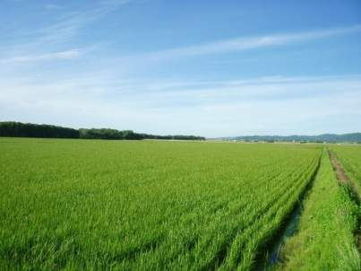
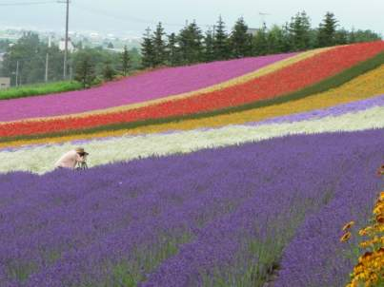
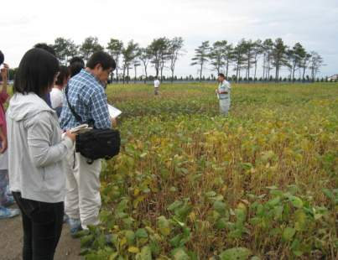
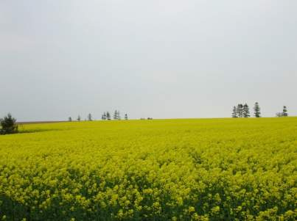
Learn Agriculture Firsthand in Hokkaido, One of Japan’s Major Food-Producing Regions
Vast Rice Paddies
Collaboration with Furano City
Training at the Experimental Farm
Extensive Farmland

Slide 33
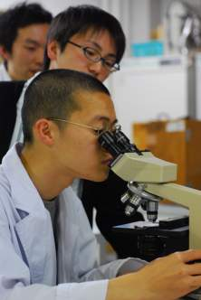
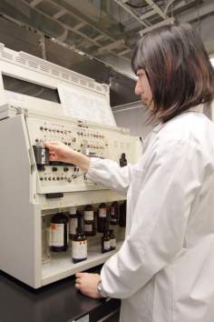
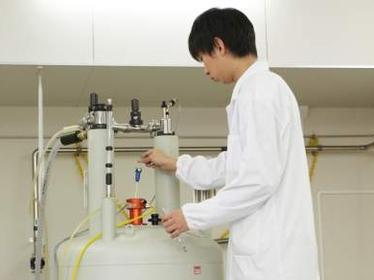
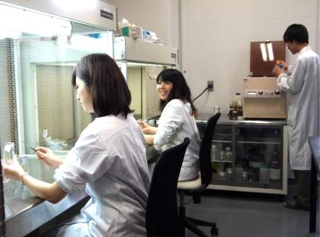
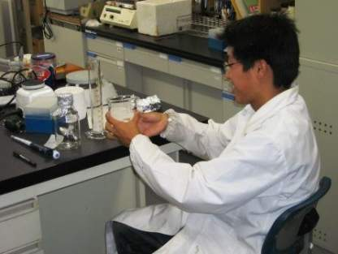
Experiments
Identifying Bacteria
Identifying Chemical Structures
Tissue Culture
DNA Extraction and Analysis

Slide 34
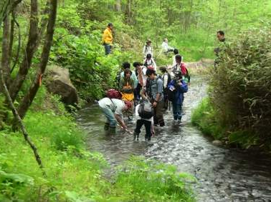
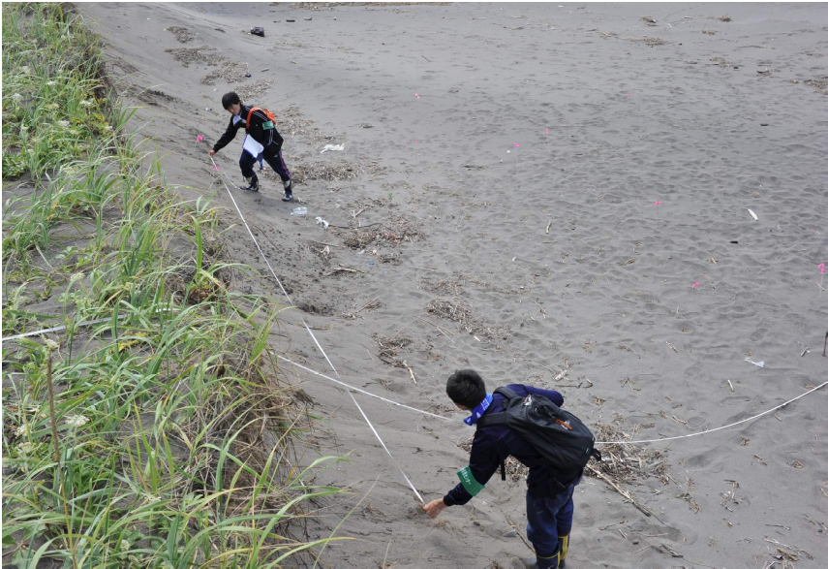
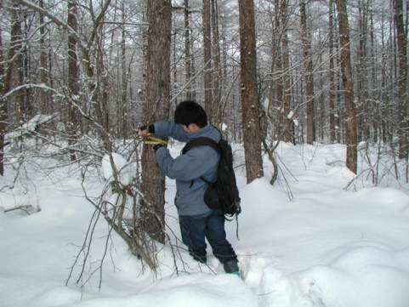
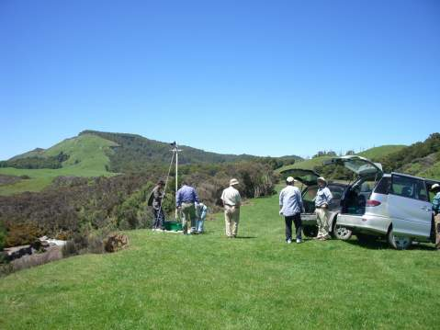
Surveys
Riverbank Survey
River Organism Survey
Surveying Trees in Winter
Meteorology

Slide 35
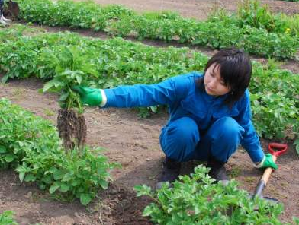
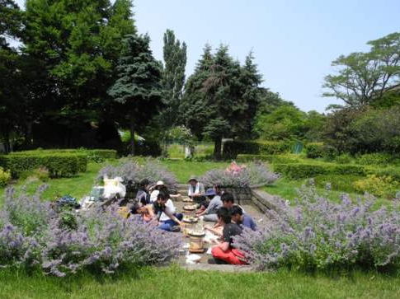
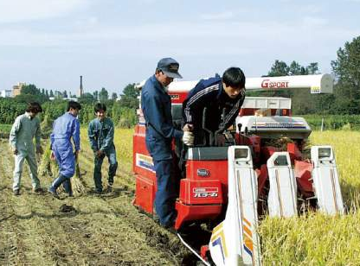
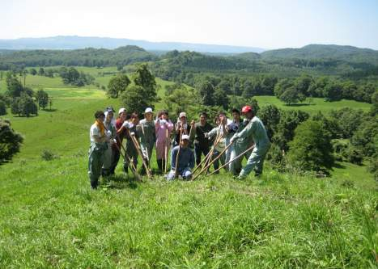
Practical Training
Potato Survey
Barbeque after a Gardening Practice
Agricultural Practice
Livestock-farm Practice

Slide 36
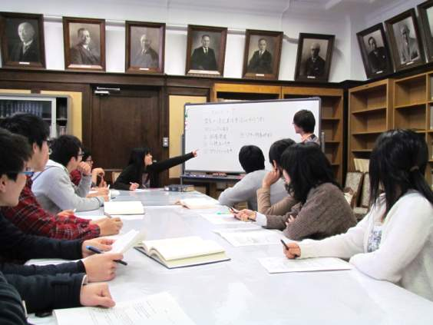
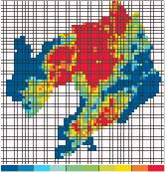
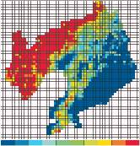
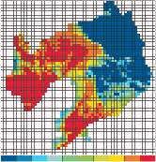
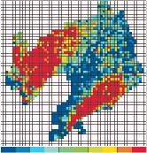
Seminars
Temperature Distribution in Liaoning Province, China
Students in a Seminar

Slide 37
Career Paths After Graduation
Other
5.0%
Other
6.3%
Private-sector Companies
14.5%
Further Education
14.3%
Civil Service /
Education & Research
10.6%
Further Education
76.8%
Private-sector Companies
68.8%
Number of Graduates: 461
(May 2026)
(May 2026)
Of those employed by private-sector companies, 33% of undergraduates and 71% of masters' graduates work in R&D departments. (Percentages varies by lab.)

Slide 38
Career Paths After Graduation (very few become farmers)
Civil Servants:
MAFF, MoE, MLIT,
Civil service at prefectural, major city, and municipality levels
Corporations:
Construction, Real Estate, Food, Chemicals, Pharmaceuticals,
Materials, Electronics, Machinery, Automotive, Transportation,
Energy Supply, Finance, Insurance, Trading Companies, Distribution,
Manufacturing and Retail, Information and Communications,
Consulting, Advertising, Publishing, Agriculture, Forestry, Education
Organizations:
Farming, forestry and fishing organizations (JA-ZENCHU etc.),
National Research and Development Agency (NARO etc.),
Civil Aviation College

Slide 39
Strengths and Features of School of Agriculture
• Outstanding faculty with expertise in each key research field
• Research in “field science” that takes advantage of Hokkaido’s vast natural environment, and in “food science” that benefits from Hokkaido’s position as one of Japan’s major food-producing regions
• A long-standing tradition of attracting talented young people from across Japan who aspire to study agricultural science, creating a culture in which students learn from and inspire one another
• Opportunities to develop an international perspective through interaction with many international students from around the world
We sincerely hope that through your studies at the School of Agriculture, Hokkaido University, you will grow as individuals, form lifelong friendships, and forge your own paths toward your goals.
We look forward to welcoming you to the School of Agriculture!

Slide 40
4. Studying at the Graduate School of Agriculture

Slide 41

The Division of Agriculture and its Three Courses
(Established April 2019)
Research Faculty of Agriculture
Field Science Center for the Northern Biosphere
Hokkaido University Museum
Division of Agriculture
Frontiers in Production Sciences
Frontiers in Biosciences
Frontiers in Environmental Sciences
Hokkaido Agricultural Research Center, National Agriculture and Food Research Organization
National Institute of Advanced Industrial Science and Technology
Bringing together faculty members from within and outside the university through the Graduate School and Research Faculty system
Other characteristics include:
T-shaped professional development
All classes now 1 credit*
Focus on research, practical credits
, etc.
Existing one-on-one guidance system
(closed system)
*Excluding “Current Advances in Regional Agricultural Bioscience"
Multifaceted supervision through a mentoring committee
expands perspectives and enhances research quality
Notes:
Learning in the Graduate School of Agriculture is characterized using the Graduate School/Research Faculty system to bring together instructors from the Research Faculty, Field Science Center for the Northern Biosphere, and University Museum, as well as supplementary external instructors from the NARO Hokkaido Agricultural Research Center and AIST to realize interdisciplinary education. Furthermore, there has been a shift from the existing system of one-on-one guidance system to multifaceted guidance through mentor committees. This enables research guidance from multiple perspectives at the planning and experimental design stage as well as course guidance with attention to students' pursuit of expertise and pertinent social issues. Other characteristics include a T-type human resources cultivation system in which a broad perspective is cultivated from the outset, followed by the evolution of expertise and the improved fluidity of studying abroad and fieldwork, with every course (with one exception) worth one credit. We also focus on research and practical credits.
.

Slide 42
Frontiers in Production Science
Through education and research on the development and utilization of plant resources such as crops, technologies for their sustainable production, and effective social institutions and distribution and utilization systems, we train professionals who contribute to the production of food and other resources essential for human survival.
Constituent Units and Specialist Fields
Unit of Agricultural Plant Science
Plant Genetics and Evolution/Plant Breeding/Pathogen-Plant Interactions/
Genetic Engineering/Cell Biology and Manipulation/Applied Plant Genomics/
Molecular Farming/Regional Agricultural Bioscience(Plant Virology)
Unit of Botany and Agronomy
Crop Science/Crop Physiology/Plant Pathology/Horticultural Science/Plant Nutrition/
Regional Agricultural Bioscience (Plant Metabolism)
Unit of Agricultural Economics
Agricultural and Environmental Policy/Farm Business Management/
Agricultural and Rural Development/Agricultural Cooperatives/
Food and Agricultural Marketing
Unit of Bioproduction Engineering
Vehicle Robotics/Agricultural and Food Process Engineering/
Agricultural Bio-System Engineering
Notes:
In 2015, the Research Faculty of Agriculture was reorganized into a new Division of Fundamental Agriscience Research, along the same lines as the seven undergraduate departments, and the existing Division of Research Innovation and Cooperation. The Division of Fundamental Agriscience Research includes the Agrobiology and Bioresources, Applied Bioscience, Bioscience and Chemistry, Forest Science, Animal Science, Bioresource and Agricultural Engineering, and Agricultural Economics research groups, corresponding to the seven departments. The Division of Research Innovation and Cooperation includes the existing Cooperative and Integrated Research Groups. This reorganization of the Research Faculty from the current four divisions and 17 fields to two divisions and nine fields has enabled the development of high-quality education and research while responding to the needs of the times, while handling educational system reform flexibly, and strictly observing the principles of education and research.

Slide 43
Frontiers in Biosciences
Through education and research on the scientific understanding and advanced utilization of biological functions and characteristics, the safe and stable supply of food and biological resources, the creation of high-value-added products through bioconversion, and the promotion of health, we train professionals who can contribute to maintenance and promotion of food security and human health.
Constituent Units and Specialist Fields
Unit of Animal Science
Animal Genetics and Reproduction/Animal Production System/
Animal Function and Nutrition/Cell and Tissue Biology/Applied Food Science/
Meat Science/Regional Agricultural Bioscience(Animal Waste Management)
Unit of Applied Molecular Biology
Applied Molecular Entomology/Molecular Biology/Molecular Enzymology
Unit of Applied Biological Chemistry
Molecular and Ecological Chemistry/Natural Product Chemistry/Biochemistry/
Food Biochemistry/Microbial Physiology/Nutritional Biochemistry/
Rhizosphere Control/Molecular Environmental Microbiology
Notes:
In 2015, the Research Faculty of Agriculture was reorganized into a new Division of Fundamental Agriscience Research, along the same lines as the seven undergraduate departments, and the existing Division of Research Innovation and Cooperation. The Division of Fundamental Agriscience Research includes the Agrobiology and Bioresources, Applied Bioscience, Bioscience and Chemistry, Forest Science, Animal Science, Bioresource and Agricultural Engineering, and Agricultural Economics research groups, corresponding to the seven departments. The Division of Research Innovation and Cooperation includes the existing Cooperative and Integrated Research Groups. This reorganization of the Research Faculty from the current four divisions and 17 fields to two divisions and nine fields has enabled the development of high-quality education and research while responding to the needs of the times, while handling educational system reform flexibly, and strictly observing the principles of education and research.

Slide 44
Frontiers in Environmental Sciences
Through education and research on the characterization, management, conservation, and multifaceted use of regional agricultural and forest resources in harmony with the environment, as well as ecosystem restoration and disaster prevention and mitigation, we train professionals who can contribute to the sustainable use of biodiversity and natural ecosystems.
Constituent Units and Specialist Fields
Unit of Ecology and Systematics
Systematic Entomology/Animal Ecology/Plant Ecology and Systematics/
Museology and Museum Material Management
Unit of Regional Environment
Ecological and Environmental Physics/Soil Conservation/Soil Science/
Land and Water Management/Regional Agricultural Bioscience (Agricultural Meteorology)
Unit of Forest Resource Utilization
Wood Chemistry/Forest Bioresource Technology/Woody Plant Biology/
Timber Engineering
Unit of Integrated Forest-Landscape Management
Ecosystem Management/Earth Surface Processes and Land Management/
Forest Policy/Ornamental Plants and Landscape Architecture/
Silviculture and Forest Ecology/Biodiversity Economics
Notes:
In 2015, the Research Faculty of Agriculture was reorganized into a new Division of Fundamental Agriscience Research, along the same lines as the seven undergraduate departments, and the existing Division of Research Innovation and Cooperation. The Division of Fundamental Agriscience Research includes the Agrobiology and Bioresources, Applied Bioscience, Bioscience and Chemistry, Forest Science, Animal Science, Bioresource and Agricultural Engineering, and Agricultural Economics research groups, corresponding to the seven departments. The Division of Research Innovation and Cooperation includes the existing Cooperative and Integrated Research Groups. This reorganization of the Research Faculty from the current four divisions and 17 fields to two divisions and nine fields has enabled the development of high-quality education and research while responding to the needs of the times, while handling educational system reform flexibly, and strictly observing the principles of education and research.

Slide 45
Research Achievements in Research Faculty and Graduate School of Agriculture
(University Rankings by Subject)
QS World University Rankings 2026 by Subject
Subject: Agriculture & Forestry
Rank | University
1 | Wageningen University & Research
2 | University of California, Davis
3 | Swedish University of Agricultural Sciences
… | …
41 | Tokyo University of Agriculture and Technology
… | …
66 | The University of Tokyo
… | …
79 | Kyoto University
… | …
93 | Hokkaido University
Tied for 4th place in Japan

Slide 46
Special English Program:
Global Education Program for Agriscience Frontiers
Period | Name (Number of Participating Labs)
1st (1997-2001) | The Special Program on Agricultural Chemistry (10 labs)
2nd (2002-2006) | The Special Program on Agricultural Chemistry (15 labs)
3rd (2007-2012) | Special English Program in Biosphere Fundamental Science (40 labs)
4th (2013-2017) | Special English Program in Biosphere Sustainability Science (43 labs)
5th (2018-2021) | Global Education Program for Agriscience Frontiers (43 labs [2018])
6th(2022-2024) | Global Education Program for Agriscience Frontiers (36 labs [2024])
7th(2025-2027) | Global Education Program for Agriscience Frontiers (35 labs [as of 2026])
A master’s and doctoral program primarily for international students from ASEAN and other countries, designed to train professionals who can contribute both to their home countries and to Japan.
A program with 25 years of experience providing English-based research supervision and education for international students primarily in the biosciences, now also combining environmental fields.
Of 71 international graduate students in agriculture, 46 (over half) are enrolled in the Special English Course (May 1, 2026)

Slide 47
Special English Program:
Three Focused Research Areas Based on Bioscience and Participating Labs
Research Faculty of Agriculture Three Focused Research Areas
[Food production]
[7 labs]
Crop Science
Animal Function and Nutrition
Vehicle Robotics
Agricultural Bio-System Engineering
Plant Nutrition
Agricultural and Rural Development
Plant Breeding
[Environmental protection]
[10 labs]
Soil Science
Land and Water Management
Ecological and Environmental Physics
Soil Conservation
Silviculture and Forest Ecology
Earth Surface Processes and Land Management
Ecosystem Management
Forest Policy
Ornamental Plants and Landscape Architecture
Forest Bioresource Technology
[Food Science]
[8 labs]
Nutritional Biochemistry
Food Biochemistry
Agricultural and Food Process Engineering
Molecular Enzymology
Biochemistry
Microbial Physiology
Applied Food Science
Cell & Tissue Biology
[Bioscience]
[10 labs]
Natural Product Chemistry, Ecological Biochemistry, Wood Chemistry, Molecular Biology
Applied Molecular Entomology, Plant Pathology, Rhizosphere Control, Basic Environmental Microbiology, Animal Ecology, Systematic Entomology
(May 1, 2026)

Slide 48
Exchanges between the Research Faculty and overseas universities and institutions
International Exchange Agreements Signed with 69 Institutions in 22 Countries (as of October 1, 2026)
People's Republic of China
Northeast Agricultural University Shenyang Agricultural University
Northeast Forestry University
Nankai University
Northwest A&F University
Shanghai Jiao Tong University
Sichuan Agricultural University
Northeast Institute of Geography and Agroecology, Chinese Academy of Sciences
Yunnan Agricultural University
Fujian Academy of Agricultural Sciences
Beijing Forestry University
College of Resources and Environment, Southwest University
College of Agriculture, Inner Mongolia Agricultural University
Nanjing Agricultural University Huazhong Agricultural University
College of Information and Electrical Engineering, China Agricultural University
University of Chinese Academy of Sciences
College of Bioscience, Guangzhou University
Institute of Environment and Sustainable Development in Agriculture, CAAS
School of Light Industry and Engineering, South China University of Technology
School of Applied Meteorology, Nanjing University of Information Science & Technology
Republic of Korea
Yeungnam University
Chungnam National University
College of Agriculture, Chonnam National University
Kangwon National University
Chungbuk National University
Hankyong National University
Graduate School, College of Natural Sciences, Seoul Women’s University
The College of Agriculture and Life Sciences, Seoul National University
Sunchon National University
Singapore
Faculty of Science, National University of Singapore
Finland
University of Oulu
University of Eastern Finland
Natural Resources Institute Finland
Myanmar
Pathein University
Lithuania
Agriculture Academy of Vytautas Magnus University
Malaysia
Universiti Malaysia Sabah
Australia
Murdoch University
Mongolia
Institute of Geography of Mongolian Academy of Sciences
Institute of Meteorology and Hydrology of National Agency for Meteorological, Hydrological and Environmental Monitoring
Faculty of Biology, National University of Mongolia
Thailand
Kasetsart University
Thammasat University
Faculty of Agriculture, Khon Kaen University
New Zealand
Institute of Geological and Nuclear Sciences Ltd
Faculty of Agriculture and Life Sciences, Lincoln University
Cambodia
Royal University of Agriculture
United States
University of Wisconsin-Madison
Ohio State University
College of Agricultural and Environmental Sciences, University of California-Davis
Italy
University of Gastronomic Sciences
Department of Agricultural, Forest and Food Sciences, University of Turin
Indonesia
University of Palangka Raya
IPB University
Faculty of Agriculture, Sriwijaya University
Indonesia International Institute for Life Sciences
Swiss German University
Faculty of Agriculture, Faculty of Agricultural Technology, Faculty of Animal Science, Brawijaya University
Canada
University of Alberta
Germany
Technical University of Munich
Brazil
Federal University of Viçosa
University of São Paulo
Taiwan
National Chung Hsing University
College of Bioresources and Agriculture, National Taiwan University
Russia
Institute for Biological Problems of the Cryolithozone, Siberian Branch of the Russian Academy of Sciences
North-Eastern Federal University
Republic of Zambia
Zambia Agriculture Research Institute
Philippines
International Rice Research Institute
University of the Philippines Los Banos College

Slide 49
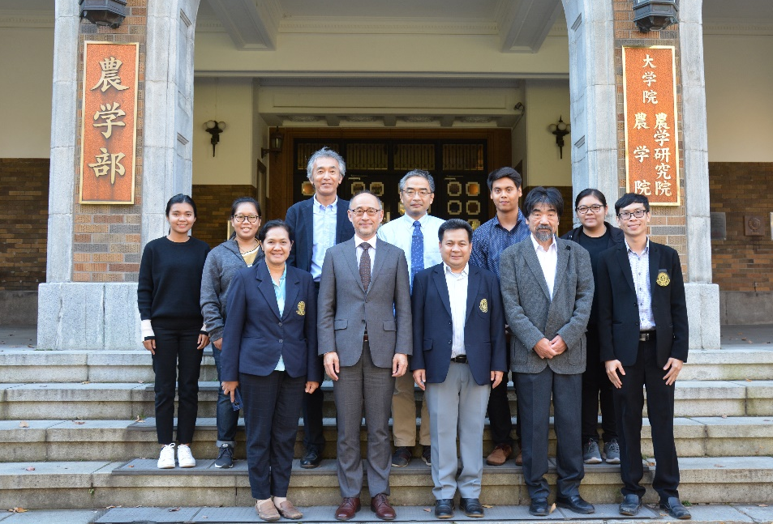
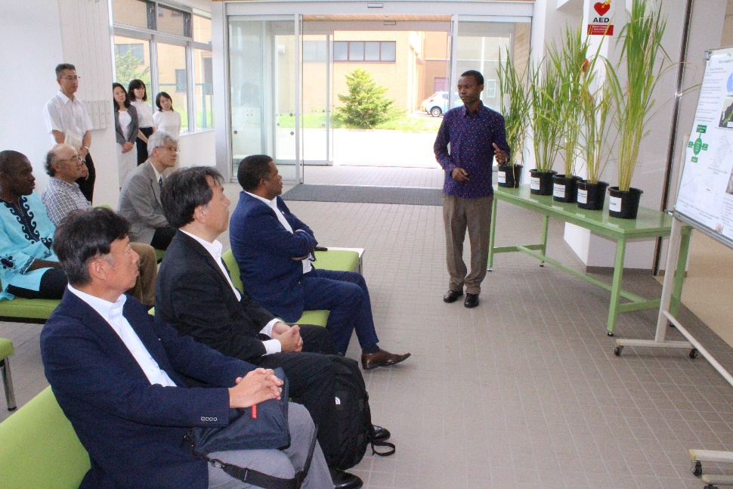
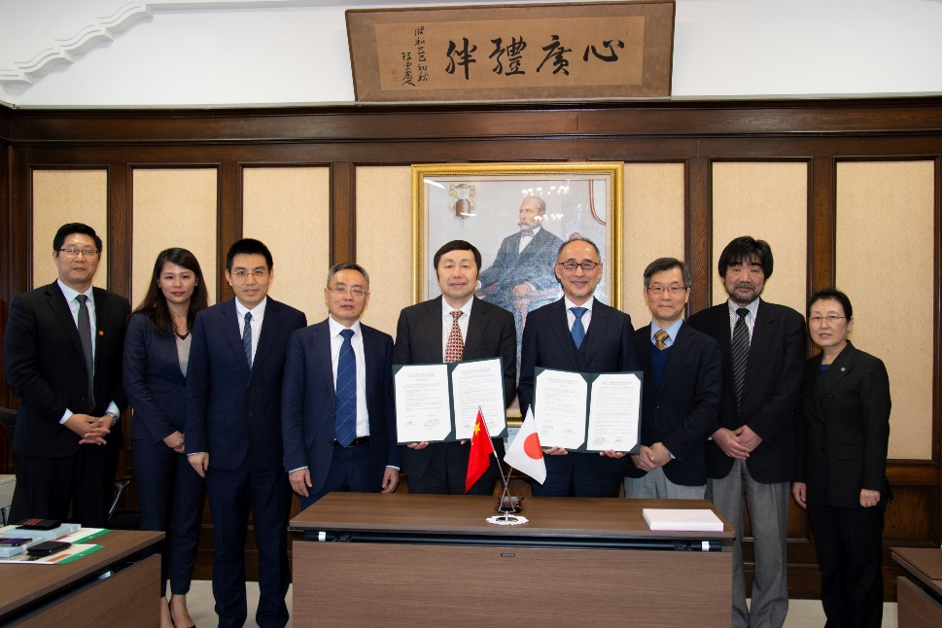
Exchanges with Universities and Institutions Overseas
Visit from Kasetsart University
Visit by the Director General of the SDG Center for Africa
Signing Ceremony with School of Life Sciences, Guangzhou University, China

Slide 50
5. Facilities and Environment

Slide 51
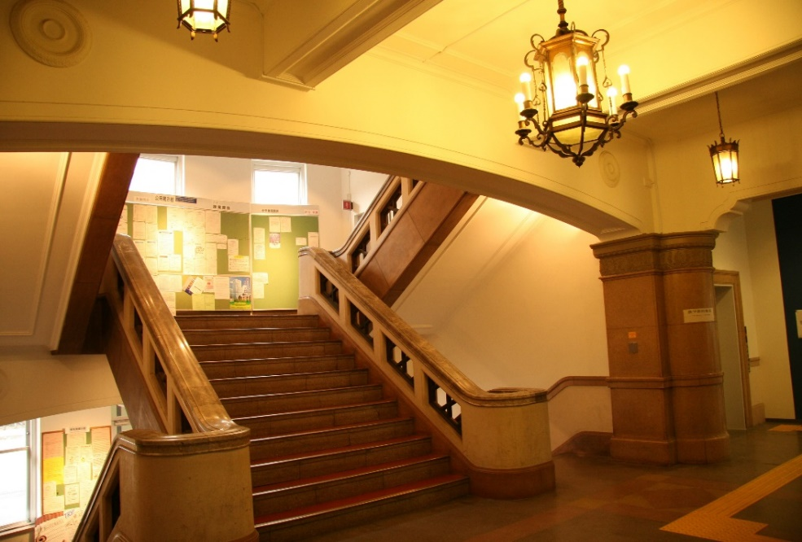
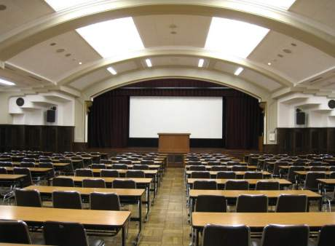
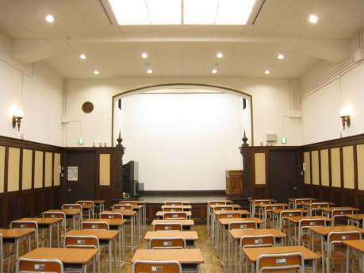
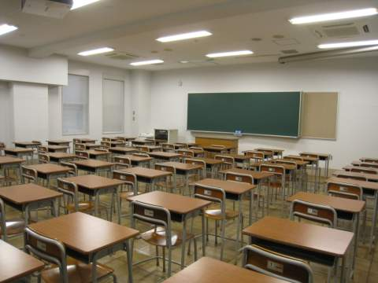
Inside the School of Agriculture
School of Agriculture Entrance Hall
Large Lecture Hall
Medium-sized Lecture Hall
Ordinary Classroom

Slide 52
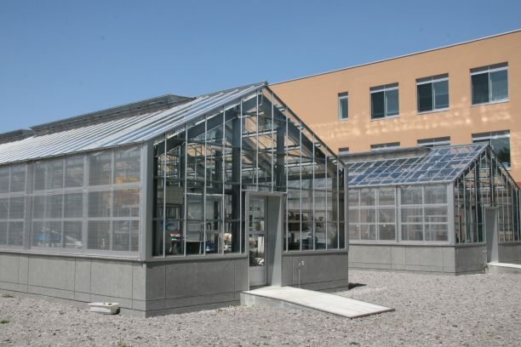
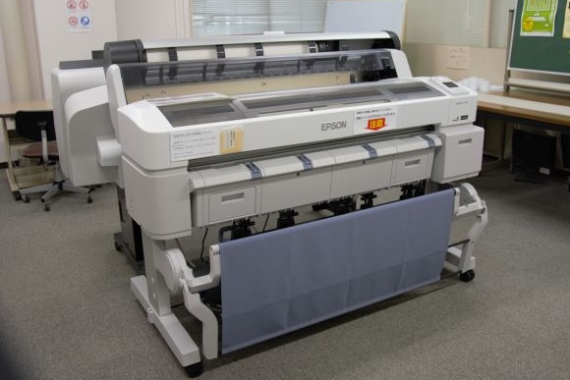
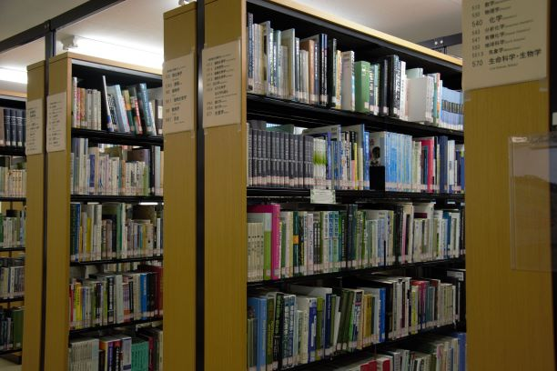
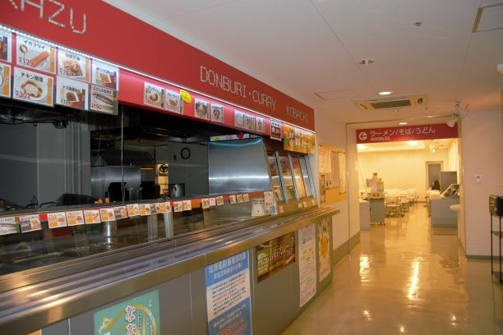
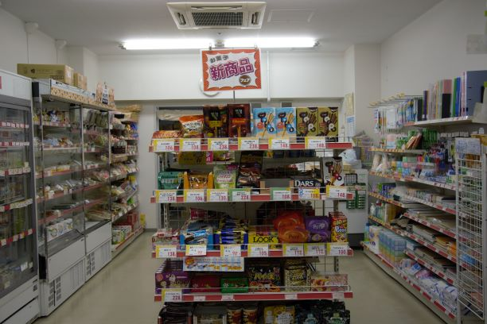
Inside the School of Agriculture
Greenhouse
IT Room
Library
Hokudai Co-op School of Agriculture Branch

Slide 53
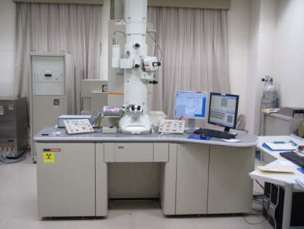
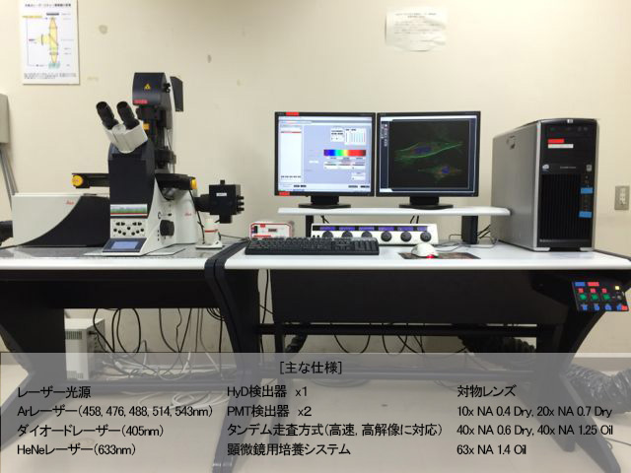
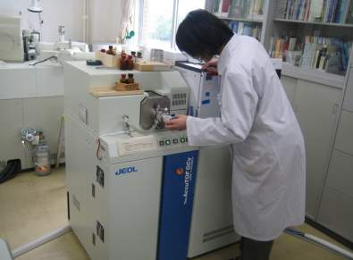

Abundant Equipment and Educational Facilities
Confocal Laser Microscope
Transmission Electron Microscope
[Main specifications]
Laser light source HyD detector x1 Objective lens
Ar laser (458, 476, 488, 514, 543 nm) PMT detector x 2 10x NA 0.4 dry, 20x NA 0.7 dry
Diode laser (405 nm) Tandem scan method (supports high-speed, high-resolution) 40x NA 0.6 dry, 40x NA 1.25 oil
HeNe laser (633 nm) Microscope cultivation system 63x NA 1.4 oil
High-resolution
Quantitative Analysis Equipment
500 MHz NMR

Slide 54



Facilities: Experimental Farms (Sapporo Farm / Yoichi Orchard)
Sapporo Farm
Yoichi Orchard
Sapporo Farm

Slide 55



Facilities: Experimental Farms (Sapporo Farm)

Slide 56



Smart Agriculture Education and Research Center
Smart Agriculture Education and Research Center
Autonomous Robot Hangar
Robot Control Room for Field Operations

Slide 57




Center for Education and Research for Hokkaido Wines
Center for Education and Research for Hokkaido Wines
Interior of “Insecta Matsumurana”
Wine Cellar “Insecta Matsumurana”

Slide 58




Facilities: Experimental Farms (Agri-Food Center)
Sausage-making
Practice
Meat Processing Plant

Slide 59




Facilities: Botanical Garden
Amazon Water Lily
Japanese Wood Poppy

Slide 60






Facilities: Livestock Farm (Shizunai)
Livestock Farm
Cattle Barn

Slide 61




Facilities: Forest Research Station / Experimental Forest

Slide 62

School of Agriculture area
Around the School of Agriculture

Slide 63




Around the School of Agriculture
Yellow star-of-Bethlehem
Central Lawn
Beer Party in the School of Agriculture Front Lawn
School of Agriculture Courtyard

Slide 64




Winter Can Be Intense, but Breathtakingly Beautiful

Slide 65
6. Appendix

Slide 66
The School of Agriculture Now
Research Keywords
"Food“ "Environment“ "Life"
Department of Agrobiology and Bioresources
- Plant protection, crop improvement, landscape
Department of Applied Bioscience
- Genome science, molecular control, genetics
Department of Bioscience and Chemistry:
- Microbes, biochemistry, food products, environmental chemistry
Department of Forest Science:
- Forest resources, environmental protection (disasters),
forest production and processing, wood materials
Department of Animal Science
- Domestic animal management, animal product use, dairy products
Department of Bioresource and Environmental Engineering
- Environmental monitoring, land use, Bio-E
Department of Agricultural Economics
- Food logistics, farming villages, environmental costs

Slide 67
Universities are tasked with the essential work of developing science and technology while furthering invention and discovery. However, every bit of this work is ultimately done by human beings. Thus, the essential work of the university is to nurture talented students capable of making a mark on society.
From Guan Zhong's "Guanzi"
To plan for one year, plant grain.
To plan for ten years, plant trees.
To plan for a lifetime, plant people.
One grain planting grants one harvest.
One tree planting grants ten harvests.
One person planted grants a lifetime's harvests.

