Slide 1
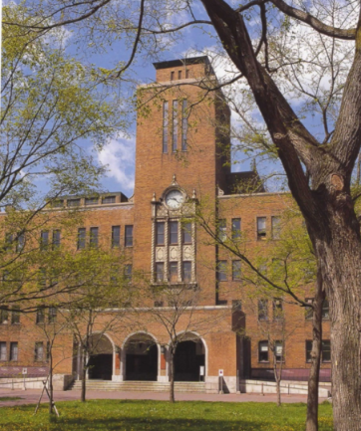
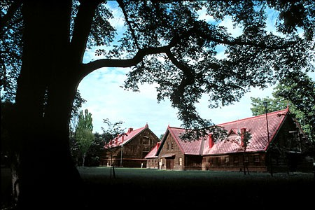
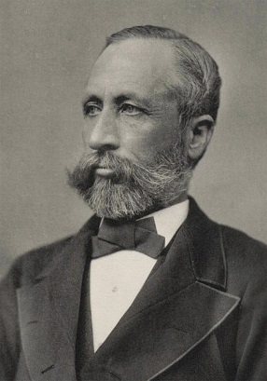
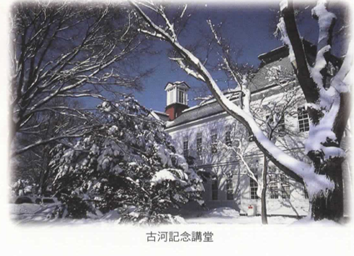
School of Agriculture, Hokkaido University :
Our 140 Years of History and Our Future to Come
Hokkaido University
Research Faculty of Agriculture / Graduate School of Agriculture
/ School of Agriculture
1

Slide 2
Contents
1. History and Philosophy
2. Organization and Personnel
3. Studying in the School of Agriculture
4. Studying in the Graduate School of Agriculture
5. Facilities and Environment
6. Appendix
P. 3
P. 13
P. 22
P. 40
P. 50
P. 63

Slide 3
1. History and Philosophy

Slide 4
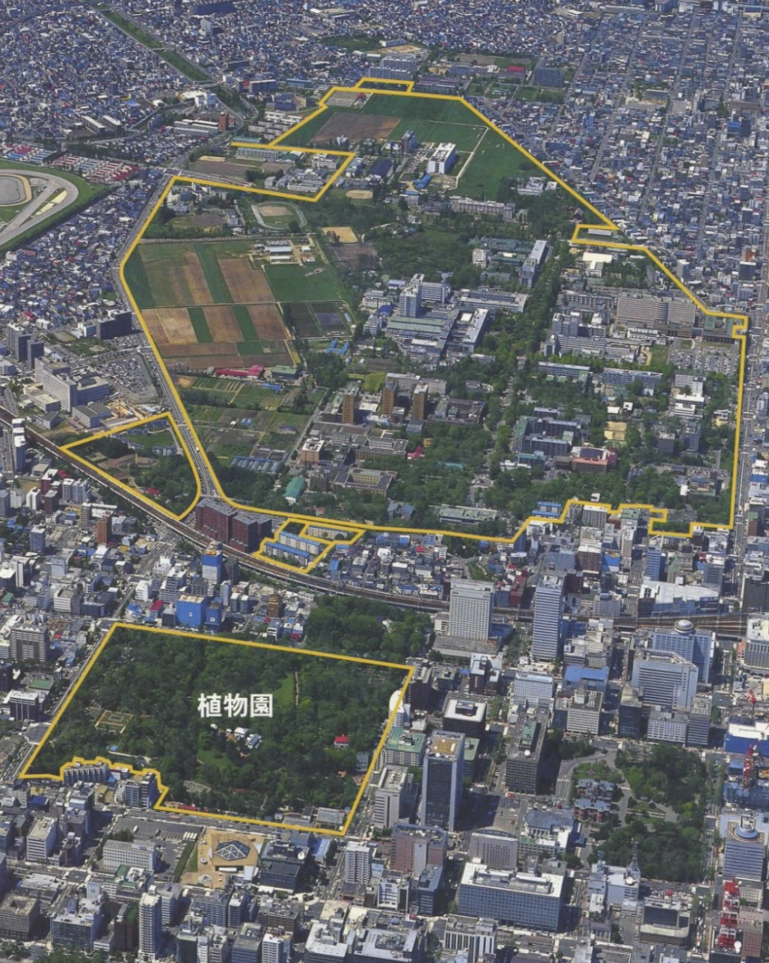
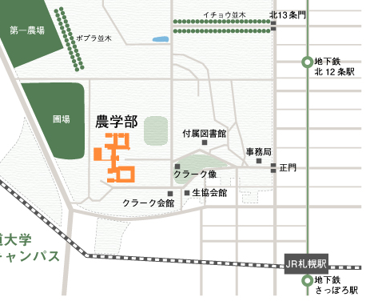
School of Agriculture, Hokkaido University
University Farm
Seedling Field

Slide 5
History of School of Agriculture, Hokkaido University
1869 Hokkaido Development Commission (HDC) established
1871 Horace Capron visited Japan, advised on establishment of agricultural
school in Hokkaido
1872 Temporary HDC school opens in Tokyo
1875 Establishment of Sapporo School by HDC
1876 Sapporo Agricultural College opened [First institution in Japan to confer
bachelors' degrees]
1907 Integration into Tohoku Imperial University Agricultural College
1918 Separation of Hokkaido Imperial University Agricultural College
1919 Hokkaido Imperial University Faculty of Agriculture
Medical/Engineering/Science opened
1947 Hokkaido University School of Agriculture
Faculties of Fisheries and Veterinary Medicine separated in 1949 and 1952
1953 Graduate School of Agriculture established
1992 School reorganized into 7 departments
2006 Graduate school reorganized into Graduate School and Research Faculty of
Agriculture
2019 Graduate school reorganized into 3 courses

Slide 6
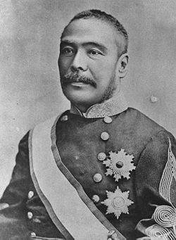
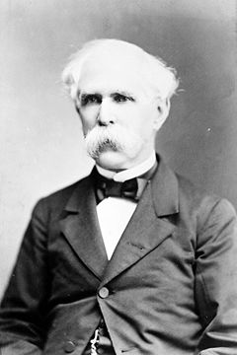
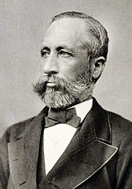
The creators of Sapporo Agricultural College
Horace Capron 1804-1885
HDC advisor (1871-1875)
US Commissioner of Agriculture
W. S. Clark
1826-1886
Assistant director (8months)
Massachusetts Agricultural College President
Kiyotaka Kuroda
1840-1900
Hokkaido Development Commissioner
Later Prime Minister

Slide 7
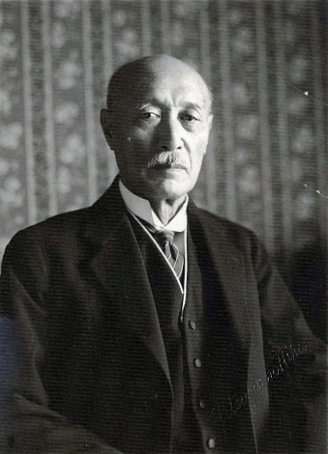
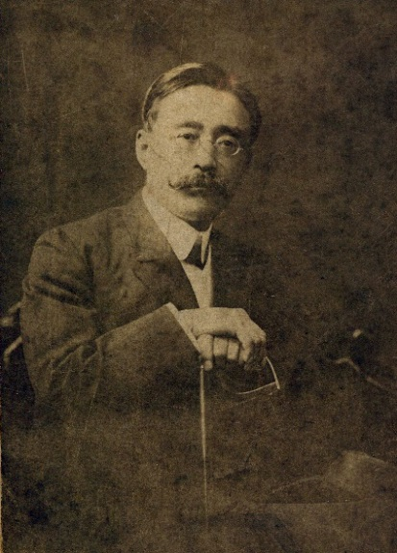
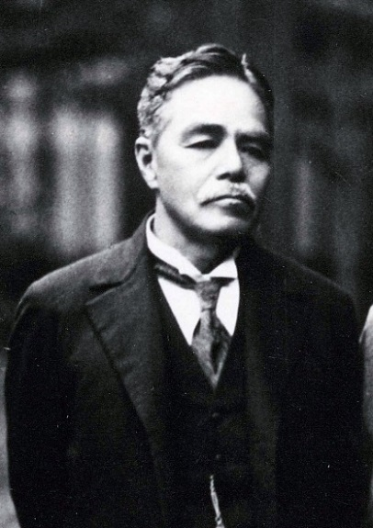
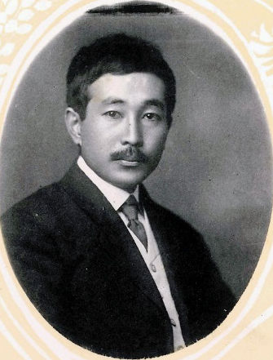
The fathers of Sapporo Agricultural College
Switch
Switch
Switch
Switch
Shosuke Sato
1856-1939
Member of the first class
Father of Hokkaido University
Director/President
(1894-1930)
Inazo Nitobe
1862-1933
Member of the second class
Professor at Hokkaido, Kyoto, Tokyo, Tokyo Women's Universities/
League of Nations Deputy Secretary-General
Author of Bushido
Kanzo Uchimura
1861-1930
Member of the second class
Thinker
Takeo Arishima
1878-1923
Member of the 19th class
Novelist
Professor

Slide 8
Principles based on the university's philosophy
Four principles cultivated over 140 years of history
Frontier Spirit
Global Perspective
All-round Education
Practical Learning

Slide 9
Issues for agriculture in the 21st century
Food, water, environment, energy: Can humanity survive?
Global population: 7.6 billion people --> 9.8 billion in 2050
Cultivated land on earth: No increase from 1.4 billion ha
World grains: 2.6 billion tons is production limit
(rice, wheat, corn)
Predicted inventory at end of FY2018/2019
: 29.5% (safety inventory level 17-18%)

Slide 10
Issues for agriculture in the 21st century
Food, water, environment, energy: Can humanity survive?
Japan's food self-sufficiency rate: 38% (lowest among developed countries)
Global climate change, water depletion
Energy crisis: Biofuels (energy vs. food)
Society at risk: All areas (failing administrative/financial systems, food crisis, economic/social fluctuations, deteriorating health and hygiene, infectious diseases, depletion of water and energy resources, giant natural disasters, radioactive pollution, etc.)

Slide 11
School of Agriculture Now
Research Faculty of Agriculture
(Faculty)
The ultimate mission of agricultural studies now:
"Establish sustainable food production technology to nourish the rapidly increasing global population"
Principle of agricultural studies:
Common awareness
"Contributing to sustainable human prosperity through the establishment of infrastructure for survival based on the biosphere"
School of Agriculture
(Undergraduates)
Graduate School of Agriculture
(Graduate students)
Notes:
What ideas do you have about agricultural studies?
The ultimate mission demanded of the school of agriculture now is to "establish sustainable food production technology to nourish the rapidly increasing global population." Based on the principle of the School of Agriculture, "contributing to sustainable human prosperity through the establishment of infrastructure for survival based on the biosphere," we pursue education and research in order to respond to these pressing issues. The School of Agriculture is a four-year undergraduate college. You will be a part of this institution if you join us. About 70% of our undergraduates go on to graduate school. This includes the master's course and the doctoral course. The Research Faculty of Agriculture is the teachers' institution. These are the three levels of our faculty.

Slide 12
School of Agriculture Now
Principle: Contributing to sustainable human prosperity through the establishment of infrastructure for survival based on the biosphere
Urgent mission: Establishing sustainable food production technology to nourish the rapidly increasing global population
Four research fields emphasized
to respond to issues
Food production
Environment
Food logistics/use
Basic bioscience
These areas are closely related; the issues above can be resolved only when they are integrated in practice.
In this way, "agricultural studies" is not limited to agricultural production but covers a wide range of related areas as an academic field.
Notes:
What ideas do you have about agricultural studies?
The ultimate mission demanded of the school of agriculture now is to "establish sustainable food production technology to nourish the rapidly increasing global population." Based on the principle of the School of Agriculture, "contributing to sustainable human prosperity through the establishment of infrastructure for survival based on the biosphere," we pursue education and research in order to respond to these pressing issues.

Slide 13
2. Organization and Personnel

Slide 14
Changes in the School of Agriculture organization:
Establishment of majors (1953)
8 divisions
Graduate School of Agriculture
Division of Agronomy
Division of Agricultural Economics
Division of Agricultural Biology
Division of Agricultural Chemistry
Division of Forestry
Division of Forest Products
Division of Animal Science
Divison of Agricultural Engineering
8 departments
School of Agriculture
Department of Agronomy
Department of Agricultural Economics
Department of Agricultural Biology
Department of Agricultural Chemistry
Department of Forestry
Department of Forest Product
Department of Animal Science
Department of Agricultural Engineering

Slide 15
Changes in the School of Agriculture organization:
Establishment of Research Faculty and Graduate School (2006 on)
3 divisions
Research Faculty of Agriculture
Division of Bioresources and Product Science
Division of Environmental Resources
Division of Applied Bioscience
4 divisions
Graduate School of Agriculture
Division of Bio-systems Sustainability
Division of Agrobiology
Division of Environmental Resources
Division of Applied Bioscience
7 departments
School of Agriculture
Department of Agrobiology and Bioresources
Department of Agricultural Economics
Department of Applied Bioscience
Department of Bioscience and Chemistry
Department of Forest Science
Department of Animal Science
Department of Agricultural Engineering

Slide 16
Changes in the School of Agriculture organization:
Establishment of the Division of Research Innovation and Streamlining (Cooperation) (2011 on)
4 divisions
Research Faculty of Agriculture
Division of Research Innovation and Cooperation
Division of Bioresources and Product Science
Division of Environmental Resources
Division of Applied Bioscience
4 divisions
Graduate School of Agriculture
Division of Bio-systems Sustainability
Division of Agrobiology and Bioresources
Division of Environmental Resources
Division of Applied Bioscience
7 departments
School of Agriculture
Department of Agrobiology and Bioresources
Department of Agricultural Economics
Department of Applied Bioscience
Department of Bioscience and Chemistry
Department of Forest Science
Department of Animal Science
Department of Agricultural Engineering
Notes:
The Research Faculty of Agriculture was originally composed of the Divisions of the three divisions of Bioresources and Product Science, Environmental Resources, and Applied Bioscience, but in April 2011, the Division for Research Innovation and Streamlining was added as a platform to promote collaboration among diverse Japanese and international organizations as well as outreach regarding basic research area outcomes, revitalizing the Research Faculty further. Thereafter, in April 2013, this Division was expanded and reorganized into the Division for Research Innovation and Collaboration, creating four divisions over 17 fields.

Slide 17
Changes in the School of Agriculture organization:
Problems (Only two faculty members in each lab and mismatch between research groups and departments)
4 divisions, 17 fields
Division of Bioresources and Product Science
Division of Environmental Resources
Division of Applied Bioscience
Research Faculty of Agriculture
Division of Research Innovation and Cooperation
Field
Field
Field
Field
Field
Field
Each division is composed of fields (various research groups)
4 divisions
Graduate School of Agriculture
Division of Bio-systems Sustainability
Division of Agrobiology and Bioresources
Division of Environmental Resources
Division of Applied Bioscience
7 departments
School of Agriculture
Department of Agrobiology and Bioresources
Department of Agricultural Economics
Department of Applied Bioscience
Department of Bioscience and Chemistry
Department of Forest Science
Department of Animal Science
Department of Bioresource and Environmental Engineering
The four divisions and 17 fields in the Research Faculty of Agriculture were based on academic fields, not in response to the seven departments.
Reduced numbers of faculty members meant that faculty could not be suitably assigned to labs, increasing faculty burdens and affecting student guidance.
The unbalanced three-school structure made staffing an issue and contributed to
personnel stagnation and aging.
Notes:
However, the four divisions and 17 fields in the Research Faculty of Agriculture were based on academic fields, not in response to the seven undergraduate departments. The organization has become extremely complicated along with the four graduate majors, the unbalanced three-school structure meant that staffing and consistent education were problems. Reduced numbers (targeted faculty reduction) meant that faculty could not be suitably assigned to labs; increasing faculty burdens along with diversification of duties made it difficult to assign educational tasks fairly and efficiently in undergraduate and graduate education and research. As well, targeted staff reduction meant that staffing stagnated and faculty average age increased. It was also important to clarify the system of responsibility for instruction from the perspective of care for students' increasingly complex and confused mental hygiene.

Slide 18
Changes in the School of Agriculture organization:
Reorganization of Research Faculty (2015 on)
2 divisions, 9 fields
Division of Fundamental Agriscience Research
Division of Research Innovation and Cooperation
Research Faculty of Agriculture
Research Group of Agrobiology and Bioresources
Research Group of Agricultural Economics
Research Group of Applied Bioscience
Research Group of Bioscience and Chemistry
Research Group of Forest Science
Research Group of Animal Science
Research Group of Bioscience and Environmental Engineering
Graduate School of Agriculture
4 divisions
Division of Bio-systems Sustainability
Division of Agrobiology and Bioresources
Division of Environmental Resources
Division of Applied Bioscience
7 departments
School of Agriculture
Department of Agrobiology and Bioresources
Department of Agricultural Economics
Department of Applied Bioscience
Department of Bioscience and Chemistry
Department of Forest Science
Department of Animal Science
Department of Bioresource and Environmental Engineering
Three-person staffing through reducing lab numbers
Imbalance eliminated with two-stage divisions
Notes:
Here, in 2015, the Research Faculty of Agriculture was reorganized into a new Division of Fundamental Agriscience Research, composed of the seven fields in the seven undergraduate departments, and the existing Division of Research Innovation and Cooperation. The Division of Fundamental Agriscience Research includes Research Groups on Agrobiology and Bioresources, Applied Bioscience, Bioscience and Chemistry, Forest Science, Animal Science, Bioresource and Agricultural Engineering, and Agricultural Economics, corresponding to the seven departments, while the Division of Research Innovation and Cooperation has the existing Cooperative and Integrated Research Groups. In this way, by reorganizing the Research Faculty from the current four divisions and 17 fields to two divisions and nine fields, it has become possible to develop high-quality education and research while responding to the needs of the times, handling educational system reform flexibly, and firmly observing the principles of education and research.

Slide 19
Changes in the School of Agriculture organization:
Reorganization of Graduate School (2019 on)
2 divisions, 9 fields
Division of Fundamental Agriscience Research
Research Faculty of Agriculture
Division of Research Innovation and Cooperation
Research Group of Agrobiology and Bioresources
Research Group of Agricultural Economics
Research Group of Applied Bioscience
Research Group of Bioscience and Chemistry
Research Group of Forest Science
Research Group of Animal Science
Research Group of Bioscience and Environmental Engineering
Graduate School of Agriculture
Division of Agriculture
1 division
Frontiers in Production Sciences
Frontiers in Biosciences
Frontiers in Environmental Sciences
School of Agriculture
Department of Agrobiology and Bioresources
Department of Agricultural Economics
Department of Applied Bioscience
Department of Bioscience and Chemistry
Department of Forest Science
Department of Animal Science
Department of Bioresource and Environmental Engineering
7 departments
In the Graduate School, 4 divisions/15 courses were reorganized to 1 division/3 courses.
The conventional borders between divisions were broken down, realizing interdisciplinary education and research guidance.
Notes:
In April 2019, the existing "four major, 15 course" system was reorganized into one major and three courses, in order to respond to social needs, student needs, and existing Graduate School issues. The Graduate School itself replaced the existing majors, divided into three courses: Frontiers in Production Sciences, in Biosciences, and in Environmental Sciences.
By removing the borders between majors, this enabled interdisciplinary research and educational guidance, realizing the focused cultivation in the new major of four capacities: (1) the capacity to take a wide view and think with a broader perspective, (2) the capacity to act individually based on advanced specialist knowledge and ethics, (3) the capacity to engage, interact, and collaborate in multiple languages, and (4) the capacity to recognize the mission of agricultural studies and give back to society.

Slide 20
Lab structure (as of April 2020)
Department of Agrobiology
and Bioresources
f
Department of Applied Bioscience
Department of Bioscience and Chemistry
Crop Science, Crop Physiology,
Plant Pathology,
Horticultural Science,
Ornamental Plants
and Landscape Architecture,
Animal Ecology,
Systematic Entomology,
Plant Genetics and Evolution,
Cell Biology and Manipulation, Pathogen-Plant Interactions,
Applied Plant Genomics
Plant Breeding, Genetic Engineering,
Applied Molecular Entomology,
Molecular Biology,
Molecular Enzymology,
Ecological Biochemistry,
Ecochemical Analysis,
Environmental Molecular Bioscience,
Genome-Enabled Biochemistry,
Plant Nutrition, Soil Science,
Natural Product Chemistry,
Biochemistry, Microbial Physiology,
Nutritional Biochemistry,
Food Biochemistry,
Rhizosphere Control,
Applied Molecular Microbiology,
Environmental Biogeochemistry
Department of Bioresource
and Environmental Engineering
Department of Animal Science
Land and Water Management,
Ecological and Environmental Physics,
Soil Conservation, Vehicle Robotics,
Agricultural and Food Process Engineering,
Agricultural Bio-System Engineering,
Applied Bioproduction Engineering,
Bioenvironmental Information Studies,
Terrestrial Ecosystem Modeling
Department of Forest Science
Silviculture and Forest Ecology,
Forest Bioresource Technology,
Ecosystem Management,
Earth Surface Processes
and Land Management,
Forest Policy, Woody Plant Biology, Timber Engineering, Wood Chemistry
Animal Genetics and Reproduction,
Animal Production System,
Animal Function and Nutrition,
Cell and Tissue Biology,
Applied Food Science
Department of Agricultural Economics
Industry Creation Research Group*
Agricultural and Environmental Policy, Farm Business Management,
Agricultural and Rural Development, Agricultural Cooperatives,
Food and Agricultural Marketing, Socio-Economics of Cooperatives,
Associations and Networks for Sustainable Rural Development,
Agricultural Resource Economics
Agrobiological Regrative medicine
Biological Control Technology
*Research organization established for joint research with private-sector organizations, etc.

Slide 21
Numbers of faculty staff and students (as of May 2020)
[Faculty]
45 professors, 34 associate professors, 27 lecturers, 17 assistant professors: 125 in total
[Students]
School of Agriculture: 681 (215 per class year x 3 years = 645)
Master's course: 359 (142 per class year x 2 years = 284)
Doctoral course: 158 (36 per class year x 3 years = 108)
Exchange students: 4 undergraduates, 40 master‘s students, 66 doctoral students: 110 in total
Those exchange students in English course: 22 master's students, 48 doctoral students: 70 in total
Notes:
From the 2019-2020 Overview of the Research Faculty of Agriculture/Graduate School of Agriculture/School of Agriculture

Slide 22
3. Studying in the School of Agriculture

Slide 23
Focused Research Areas (1)
○ Food production
As its population increases, the world is suffering from severe food shortages.
To achieve a solution swiftly, research at the School of Agriculture aims for environmentally conscious, efficient food production.
○ Environment
As human activity dramatically affects the earth's environment, it will be imperative for us to move toward a major shift in the use of bioresources, soil, water resources, and energy.
Through cutting-edge research, we plan to address the fundamental issue of reducing the burden on the natural environment while enabling people to live fulfilling lives.
Notes:
You have probably grasped the wide range of academic fields that awaits your diverse interests. Rather than studying your own interests alone, however, as noted above you should be thoroughly aware and proactive about how your research contributes to the achievement of objectives. This is an essential stance as you approach your experience as a student in the School of Agriculture. For example, what if you like insects? You cannot simply devote yourself to classifying insects and discovering new species. Instead, you should remain aware of the contributions your work can make to food production. For example, insect elimination can contribute to increased food production. This is what it means to study entomology in the School of Agriculture, in contrast to the School of Science.

Slide 24
Focused Research Areas (2)
○ Food logistics / use
Social sciences research is helping to address many issues, such as diversifying food needs, safe supply, and developing logistics and markets.
○ Basic bioscience
We still have only the faintest idea of the potential of biology.
The School of Agriculture is working to apply this potential while clarifying the mysteries of life through the power of biotechnology and keeping in mind the development of bioresources.
Along with the use of organisms' inherent capacities, we also develop technology that enables new functions.
This includes elucidating the relationship between food and health.
Notes:
You have probably grasped the wide range of academic fields that awaits your diverse interests. Rather than studying your own interests alone, however, as noted above you should be thoroughly aware and proactive about how your research contributes to the achievement of objectives. This is an essential stance as you approach your experience as a student in the School of Agriculture. For example, what if you like insects? You cannot simply devote yourself to classifying insects and discovering new species. Instead, you should remain aware of the contributions your work can make to food production. For example, insect elimination can contribute to increased food production. This is what it means to study entomology in the School of Agriculture, in contrast to the School of Science.

Slide 25
Globalization of education
Short-term overseas language study programs (spring/summer programs)
Students participate in programs sponsored by our partner schools, using the spring or summer vacations for short-term study overseas. In addition to language, these fulfilling programs offer an opportunity to study the culture of the host country.
Exchange programs (study at partner schools)
Students spend a term or more (but less than a year) studying at a partner university. In this program, tuition is paid to Hokkaido University, rendering studies at the partner school free of charge.
Special Postgraduate Program in Biosphere Sustainability Science
(Special English Program)
Hokkaido Summer Institute
Hokkaido University Learning Satellite
PARE Program
Quarter System
Cotutelle Program
JASSO Overseas Study Support System (Partner Dispatch)
Leap for Tomorrow Study Abroad Initiative Young Ambassador Program

Slide 26
Globalization of education
Nitobe College
Learning at the College aims not only to cultivate a breadth of knowledge but also to inspire in individual students a sense of independence and Japanese identity, while also cultivating the leadership needed in international society.
[Undergraduate Program]
The College program consists of the basic program (first year) and the honors program (second year through graduation).
Through the courses in the Nitobe curriculum, students master a range of knowledge and experience over four years.
This interdisciplinary curriculum is open to students in all twelve undergraduate schools at Hokkaido University.
It is intended that all students study abroad for at least one semester.
Classes in English for overseas study, as well as English-language international exchange and school specialized courses, are offered.
Classes on multicultural exchange, with exchange students from other countries and regions, are offered.
Students who have obtained the 15 credits necessary and completed the other requirements receive certificates of completion.
Notes:
Reflecting our philosophy, these programs constitute specific frameworks for the cultivation of internationality and have become particularly popular over the last two to three years.

Slide 27
Globalization of education
[Graduate Program]
Consists of the Basic Program, open to all master’s course students, and the Honors Program, in which students apply the knowledge and skills learned previously in more practical project work.
The Nitobe College graduate education course focuses on team learning. Throughout the process, students learn the skills of facilitating creative and constructive team discussion, identifying their own issues, using their expertise in discussion to arrive at solutions, and presenting their results.
The objective is to cultivate "human resources with the advanced expertise and high ethical stance as experts to enable them to form teams with people of diverse social and cultural backgrounds, to predict, discover, and solve the problems of global society, and to contribute to the creation of new social values."

Slide 28
Available Qualifications
Teaching license
[Teaching licenses available from the Graduate School and School of Agriculture]
・ Junior high school Type 1 license [Social studies]: Department of Agricultural Economics
・ High school Type 1 license [Civics]: Department of Agricultural Economics
・ High school Type 1 license [Science]: All six departments except the Department of
Agricultural Economics
・ High school Type 1 license [Agriculture]: All departments of the School of Agriculture
・ High school advanced license [Agriculture]: All departments of the Graduate School of
Agriculture
Food Hygiene Manager and Food Hygiene Monitor
Domestic Animal Inseminator
Assistant Registered Surveyor
Assistant Arborist
Assistant Regenerative Naturalist
Class A Hazardous Materials Engineer (qualified for testing)
Class 2 Forest Information Technician
Curator

Slide 29
Student capacity per year of each department
Department | General entrance exam* | Entrance exam by department
Department of Agrobiology and Bioresources | 27 | 9
Department of Applied Bioscience | 23 | 7
Department of Bioscience and Chemistry | 26 | 9
Department of Forest Science | 27 | 9
Department of Animal Science | 17 | 6
Department of Bioresource and Environmental Engineering | 23 | 7
Department of Agricultural Economics | 19 | 6
Total | 162 | 53 (215)
*Departments determined by individual preference and first-year grades.
Notes:
From the School of Agriculture Students' Guide "IV. Specialist Courses and Academic Advancement 1) 1. Accepted Student Numbers"

Slide 30
Students from all over Japan enroll in School of Agriculture.
Ranking of prefecutures
where students come from
(Outside Hokkaido)
Tokyo 76
Aichi 45
Hyogo 41
Osaka 40
Kanagawa 33
Shizuoka 27
Kyoto 25
Saitama 23
Chiba 21
Ibaraki 16
Home regions of students in the school
(October 2019)
...

Slide 31
Education program
Acquiring broad-based knowledge
Acquire specialist knowledge needed for research
University-wide common education
Specialist education in the School
Senior thesis
Freshmen
Sophomores
Juniors
Seniors
Overall education
School of Agriculture
/ departments
Labs
Graduation
Decide on your department
by the end of the first year.
Decide on your lab
in the first or second
semester of the third year.

Slide 32
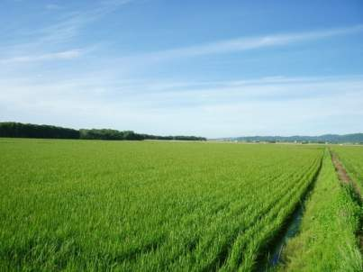
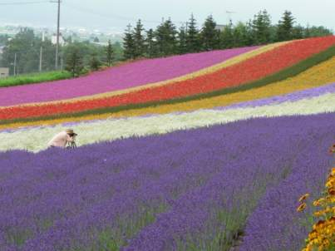
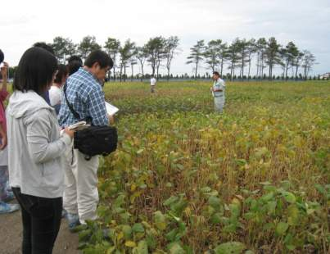
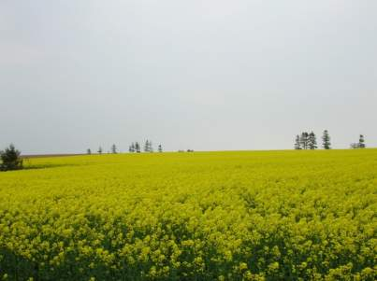
Learn agriculture up close in Hokkaido, major food base of Japan
Vast rice paddies
Collaboration with Furano City
Training at the Experimental Farm
Extensive farmland

Slide 33
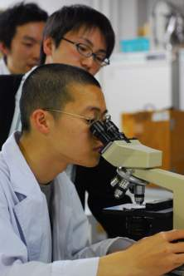
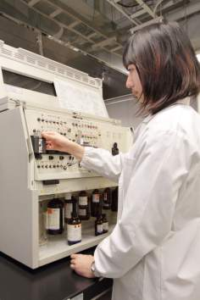
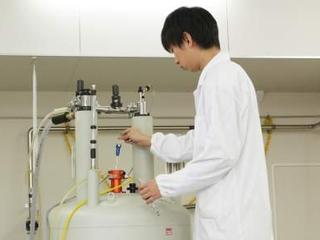
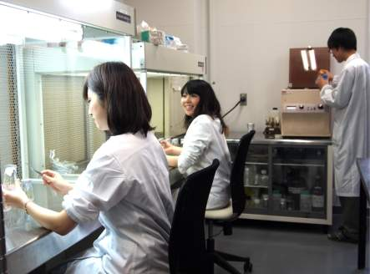
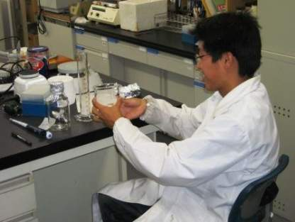
Experiments
Identifying bacteria
Identifying chemical structures
Tissue culture
DNA extraction and analysis

Slide 34
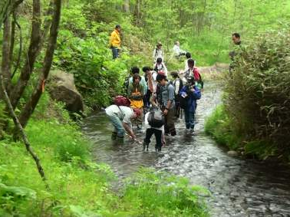
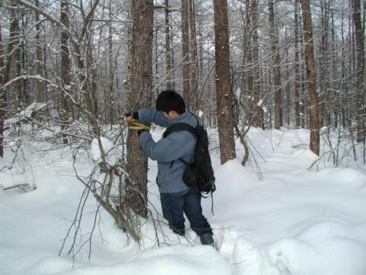
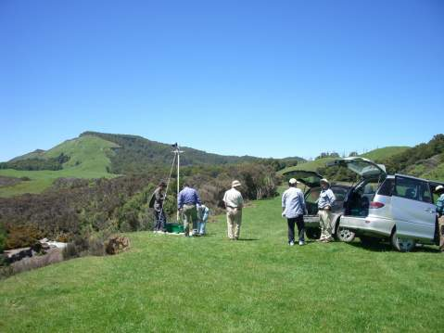
Surveys
Riverbank transect
River organism survey
Surveying trees in winter
Meteorology

Slide 35
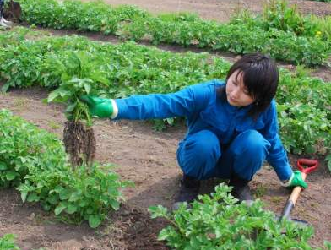
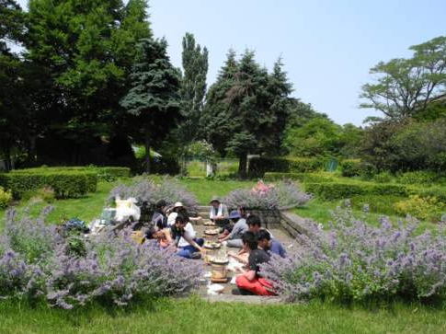
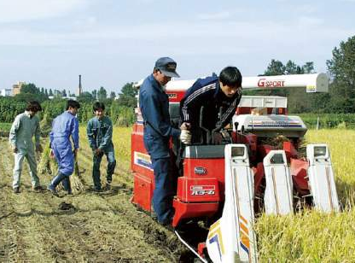
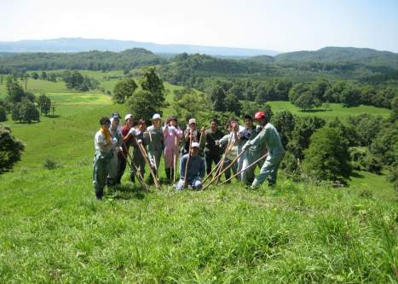
Practices
Potato survey
Barbeque after garden practice
Farm practice
Livestock farm practice

Slide 36
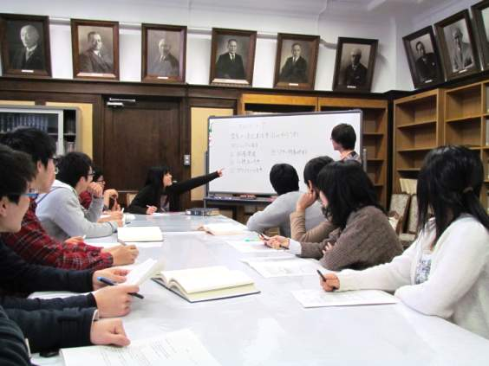
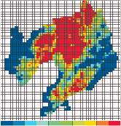
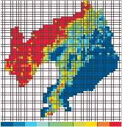
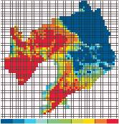
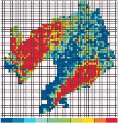
Seminars
Temperature distribution in Liaoning Province, China
Students in seminar

Slide 37
After graduation career paths
Other
4.5%
Other
7.2%
Further education
12.9%
Private-sector companies
14.5%
Civil service/education & research
14.2%
Further education
73.2%
Private-sector companies
65.7%
(April 2019)
(April 2019)
39% of undergraduates and 73% of masters' graduates at private-sector companies are employed in R&D departments. (Ratio varies by lab.)

Slide 38
Graduates' career paths (very few become farmers)
Civil servants:
MAFF, MoE, MLIT,
Civil service at prefectural, major city, and municipality levels
Corporations:
Brewing, fermentation, food products, cosmetics,
chemical industry, medicine/pharmaceuticals, trading companies, pulp/paper production, wood products, housing, greenery, gardening, logistics, finance, trading companies, consulting, information software, environmental corporations, news media.
Organizations:
Farming, forestry and fishing organizations (JA-ZENCHU etc.)

Slide 39
Strengths and Features of School of Agriculture
Superb faculty with expertise in each focused research area
Research related to "field science" utilizing the vast natural resources of Hokkaido and "food science" making the most of Hokkaido's status as the breadbasket of Japan
Tradition of gathering gifted young would-be agriculturalists from throughout Japan in a climate of mutual learning
International sensibility acquired through large numbers of foreign exchange students
We hope that through your study at the Hokudai School of Agriculture, you will enhance your humanity, acquire lifelong friends, and move confidently toward your own goals.
We look forward to welcoming you at the School of Agriculture.

Slide 40
4. Studying in the Graduate School of Agriculture

Slide 41
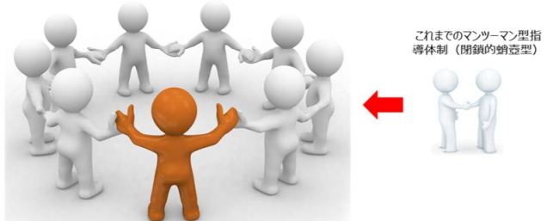
Division of Agriculture and its three courses (established April 2019)
Research Faculty of Agriculture
Field Science Center for the Northern Biosphere
Hokkaido University Museum
Division of Agriculture
Frontiers in Production Sciences
Frontiers in Biosciences
Frontiers in Environmental Sciences
Hokkaido Agricultural Research Center, National Agriculture and Food Research Organization
National Institute of Advanced Industrial Science and Technology
University & external instructors gather, optimizing the Graduate School and Research Faculty system.
Other characteristics include:
T-type human resources cultivation system
All classes now 1 credit*
Focus on research, practical credits, etc.
Existing one-on-one guidance system
(closed bubble type)
*Excluding "Special Topics in Basics of Hokkaido Agricultural Production"
Multifaceted guidance through a mentor committee
expands perspectives and enhances research quality
Notes:
Learning in the Graduate School of Agriculture is characterized using the Graduate School/Research Faculty system to bring together instructors from the Research Faculty, Field Science Center for the Northern Biosphere, and University Museum, as well as supplementary external instructors from the NARO Hokkaido Agricultural Research Center and AIST to realize interdisciplinary education. Furthermore, there has been a shift from the existing system of one-on-one guidance system to multifaceted guidance through mentor committees. This enables research guidance from multiple perspectives at the planning and experimental design stage as well as course guidance with attention to students' pursuit of expertise and pertinent social issues. Other characteristics include a T-type human resources cultivation system in which a broad perspective is cultivated from the outset, followed by the evolution of expertise and the improved fluidity of studying abroad and fieldwork, with every course (with one exception) worth one credit. We also focus on research and practical credits.
.

Slide 42
Frontiers Course in Production Science
The aim is to produce experts capable of contributing to the production of foods and resources indispensable for human survival. It is hoped that, through education and research, these experts will advance developments in the usability and functionality of plants and bioresources, establishment of technologies for sustainable reproduction thereof, and social systems for effective distribution and utilization.
Constituent units and specialist fields
Unit of Agricultural Plant Science
Plant Genetics and Evolution/Plant Breeding/Pathogen-Plant Interactions/Genetic Engineering/Cell Biology and Manipulation/Applied Plant Genomics/Plant Usable Material Production
Unit of Botany and Agronomy
Crop Science/Crop Physiology/Plant Pathology/Horticultural Science/Plant Nutrition/
Basics of Hokkaido Agricultural Production
Unit of Agricultural Economics
Agricultural and Environmental Policy/Farm Business Management/Agricultural and Rural Development/Agricultural Cooperatives/Food and Agricultural Marketing
Unit of Bioproduction Engineering
Vehicle Robotics/Agricultural and Food Process Engineering/Agricultural Bio-System Engineering
Notes:
In 2015, the Research Faculty of Agriculture was reorganized into a new Division of Fundamental Agriscience Research, along the same lines as the seven undergraduate departments, and the existing Division of Research Innovation and Cooperation. The Division of Fundamental Agriscience Research includes the Agrobiology and Bioresources, Applied Bioscience, Bioscience and Chemistry, Forest Science, Animal Science, Bioresource and Agricultural Engineering, and Agricultural Economics research groups, corresponding to the seven departments. The Division of Research Innovation and Cooperation includes the existing Cooperative and Integrated Research Groups. This reorganization of the Research Faculty from the current four divisions and 17 fields to two divisions and nine fields has enabled the development of high-quality education and research while responding to the needs of the times, while handling educational system reform flexibly, and strictly observing the principles of education and research.

Slide 43
Frontiers Course in Biosciences
The aim is to produce experts capable of contributing to the maintenance and promotion of food and health. Through education and research, they may promote scientific understanding and advanced utilization of biotic functions and characteristics, safe and stable supply of food (biological) resources, the production of value-added products through bioconversion, and the advancement of health.
Constituent units and specialist fields
Unit of Animal Science
Animal Genetics and Reproduction/Animal Production System/Animal Function and Nutrition/Cell and Tissue Biology/
Applied Food Science/Meat Science
Unit of Applied Molecular Biology
Applied Molecular Entomology/Molecular Biology/Molecular Enzymology
Unit of Applied Biological Chemistry
Ecological Biochemistry/Natural Products/Biochemistry/Food Biochemistry/
Microbial Physiology/Nutritional Biochemistry/Rhizosphere Control/Ecochemical Analysis/
Intestinal Flora Microbiology/Basic Environmental Microbiology
Notes:
In 2015, the Research Faculty of Agriculture was reorganized into a new Division of Fundamental Agriscience Research, along the same lines as the seven undergraduate departments, and the existing Division of Research Innovation and Cooperation. The Division of Fundamental Agriscience Research includes the Agrobiology and Bioresources, Applied Bioscience, Bioscience and Chemistry, Forest Science, Animal Science, Bioresource and Agricultural Engineering, and Agricultural Economics research groups, corresponding to the seven departments. The Division of Research Innovation and Cooperation includes the existing Cooperative and Integrated Research Groups. This reorganization of the Research Faculty from the current four divisions and 17 fields to two divisions and nine fields has enabled the development of high-quality education and research while responding to the needs of the times, while handling educational system reform flexibly, and strictly observing the principles of education and research.

Slide 44
Frontiers Course in Environmental Sciences
The aim is to produce experts capable of contributing to biodiversity and the sustainable use of the natural ecosystem. These experts, through education and research, will advance knowledge of the characteristics of local agriculture and forest resources, their management, conservation, and multifaceted use, as well as environmental harmony, ecosystem restoration, and disaster prevention/mitigation.
Constituent units and specialist fields
Unit of Ecology and Systematics
Systematic Entomology/Animal Ecology/Evolution/Behavioral Ecology/Plant Ecology/Systematics/Museum Studies/Specimen Studies
Unit of Regional Environment
Ecological and Environmental Physics/Soil Conservation/Soil Science/Land and Water Management/Bioenvironmental Information Studies/Basics of Hokkaido Agricultural Production
Unit of Forest Resource Utilization
Wood Chemistry/Forest Bioresource Technology/Woody Plant Biology/Timber Engineering
Unit of Integrated Forest-Landscape Management
Ecosystem Management/Earth Surface Processes and Land Management/Forest Policy/Ornamental Plants and Landscape Architecture/Silviculture and Forest Ecology
Notes:
In 2015, the Research Faculty of Agriculture was reorganized into a new Division of Fundamental Agriscience Research, along the same lines as the seven undergraduate departments, and the existing Division of Research Innovation and Cooperation. The Division of Fundamental Agriscience Research includes the Agrobiology and Bioresources, Applied Bioscience, Bioscience and Chemistry, Forest Science, Animal Science, Bioresource and Agricultural Engineering, and Agricultural Economics research groups, corresponding to the seven departments. The Division of Research Innovation and Cooperation includes the existing Cooperative and Integrated Research Groups. This reorganization of the Research Faculty from the current four divisions and 17 fields to two divisions and nine fields has enabled the development of high-quality education and research while responding to the needs of the times, while handling educational system reform flexibly, and strictly observing the principles of education and research.

Slide 45
Research Achievements in Research Faculty and Graduate School of Agriculture
(University rankings by subject)
QS World University Rankings 2020 by Subject
Subject: Agriculture & Forestry
Rank | University
1 | Wageningen University
2 | University of California, Davis
3 | Cornell University
... | ...
22 | The University of Tokyo
33 | Kyoto University
... | ...
82 | Tohoku University
... | ...
132 | Hokkaido University
132 | Kyushu University
Tied for 4th place in Japan
Gakujutsu Shuppansha

Slide 46
Special English Program:
Global Education Program for Agriscience Frontiers Program
Period | Name (number of participating labs)
1st (1997-2001) | The Special Program on Agricultural Chemistry (10 labs)
2nd (2002-2006) | The Special Program on Agricultural Chemistry (15 labs)
3rd (2007-2012) | Special English Program in Biosphere Fundamental Science (40 labs)
4th (2013-2017) | Special English Program in Biosphere Sustainability Science (43 labs)
5th (2018-2022) | Global Education Program for Agriscience Frontiers (43 labs [as of 2018])
A combined master's/doctoral program, accepting exchange students from the ASEAN countries (China, South Korea, etc.) to cultivate effective human resources both for these countries and for Japan.
A program with 15 years of English-language research guidance and education for exchange students in the biosciences, now also combining and developing environmental fields.
Of 120 graduate exchange students in agriculture, 69 (over half) are enrolled in the English Course (May 1, 2019)

Slide 47
Special English Program:
Three focused research areas based on bioscience and participating labs
Research Faculty of Agriculture three focused research areas
[Food production]
[9 labs]
Animal Function and Nutrition
Vehicle Robotics
Agricultural Bio-System Engineering
Plant Nutrition
Agricultural and Rural Development
Animal Genetics and Reproduction
Plant Breeding
Animal Production System
Applied Plant Genomics
[Environmental protection]
[9 labs]
Soil Science
Land and Water Management
Ecological and Environmental Physics
Soil Conservation
Silviculture and Forest Ecology
Earth Surface Processes and Land Management
Ecosystem Management
Forest Policy
Ornamental Plants and Landscape Architecture
[Food Science]
[7 labs]
Nutritional Biochemistry
Food Biochemistry
Agricultural and Food Process Engineering
Molecular Enzymology
Biochemistry
Microbial Physiology
Applied Food Science
[Bioscience]
[11 labs]
Natural Product Chemistry, Ecological Biochemistry, Wood Chemistry, Molecular Biology
Applied Molecular Entomology, Plant Pathology, Rhizosphere Control, Ecochemical Analysis, Basic Environmental Microbiology, Animal Ecology, Systematic Entomology
(October 1, 2019)

Slide 48
Exchanges between the Research Faculty and overseas universities and institutions
International exchange agreements signed with 65 institutions in 22 countries (as of May 1, 2019)
People's Republic of China
Northeast Agricultural University Shenyang Agricultural University
Northeast Forestry University Nankai University
Northwest A&F University
Shanghai Jiao Tong University
Sichuan Agricultural University
Northeast Institute of Geography and Agroecology, Chinese Academy of Sciences
Yunnan Agricultural University
Fujian Academy of Agricultural Sciences
Beijing Forestry University
Southwest University College of Resources and Environment
Inner Mongolia Agricultural University College of Agriculture
Huazhong Agricultural University College of Resources and Environment
Nanjing Agricultural University Huazhong Agricultural University
China Agricultural University College of Information and Electrical Engineering
University of Chinese Academy of Sciences
China Guangzhou University College of Bioscience
Republic of Korea
Yeungnam University
Chungnam National University
Chonnam National University College of Agriculture
Kangwon National University Chungbuk National University Hankyong National University
Seoul Women's University Graduate School/College of Natural Sciences
Gyeongnam National University of Science and Technology
Thailand
Kasetsart University
Thammasat University
Royal Ministry of Agriculture and Cooperatives/Geo-Informatics and Space Technology Development Agency
Khon Kaen University Faculty of Agriculture
Finland
University of Oulu University of Eastern Finland
Lithuania
Vytautas Magnus University
Agriculture Academy
Malaysia
Sarawak Tropical Peat Research Institute
Universiti Malaysia Sabah
Australia
University of Sydney
Western Sydney University
India
Indian Institute of Technology Guwahati Department of Biosciences and Bioengineering
Mongolia
Institute of Geography and Geoecology, Mongolian Academy of Sciences
Mongolian National Agency of Meteorology and Environment Monitoring, Central Laboratory of Environment and Meteorology
National University of Mongolia Institute of Ecology
New Zealand
GNS Science
Lincoln University Faculty of Agriculture and Life Sciences
Indonesia
University of Palangka Raya
IPB University
Sriwijaya University Faculty of Agriculture
Peatland Restoration Agency
Indonesia International Institute for Life Sciences
Swiss German University
United States
University of Wisconsin-Madison
Ohio State University
College of Agricultural and Environmental Sciences, University of California-Davis
Italy
University of Gastronomic Sciences
Germany
Technical University of Munich
Taiwan
National Chung Hsing University
Singapore
National University of Singapore Faculty of Science
Russia
Siberian Branch of the Russian Academy of Sciences, Institute for Biological Problems of the Cryolithozone
North-Eastern Federal University
Canada
University of Alberta
Cambodia
Royal University of Agriculture
Myanmar
Pathein University
Brazil
Federal University of Viçosa University of São Paulo
Philippines
International Rice Research Institute

Slide 49
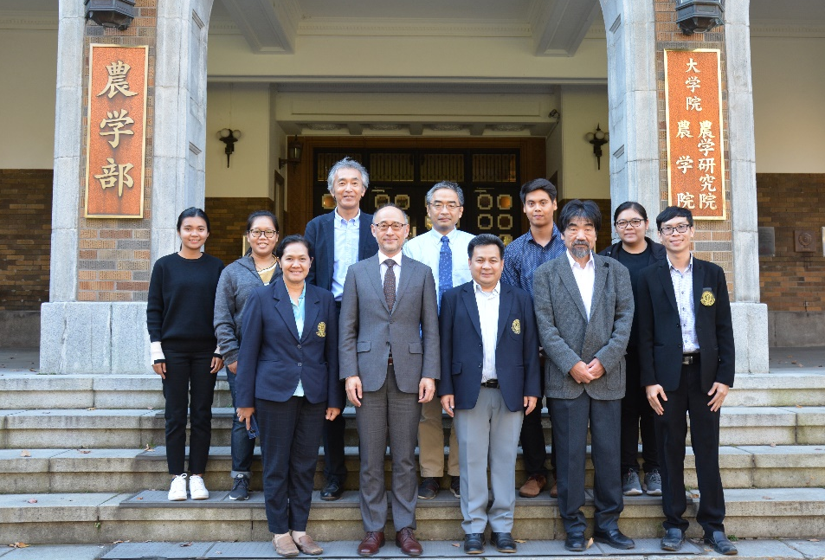
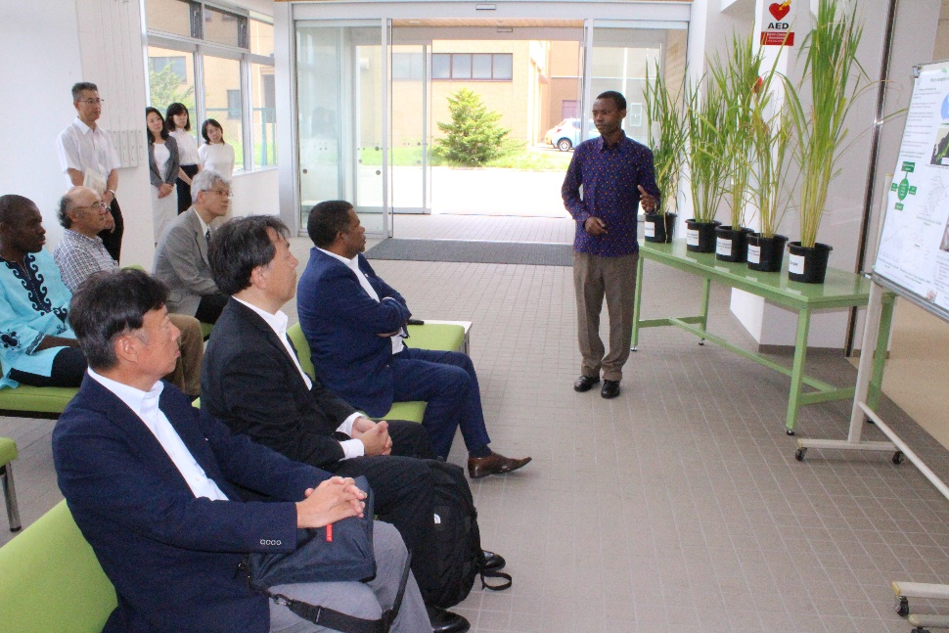
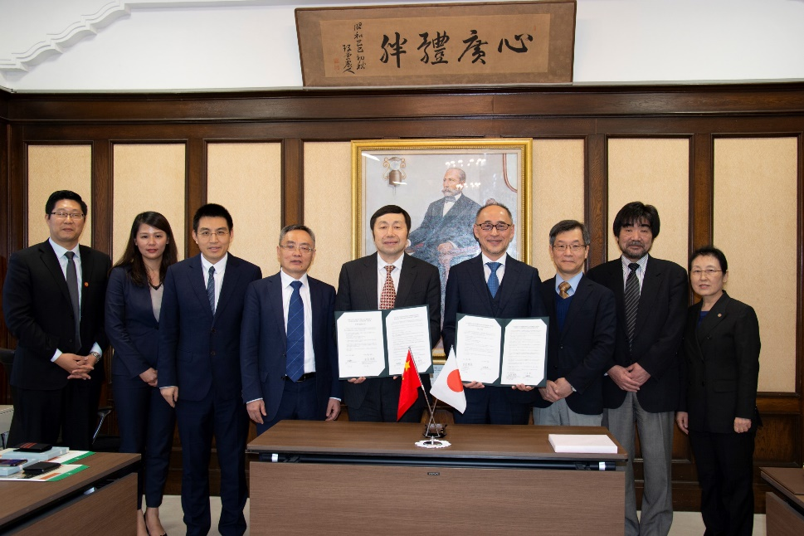
Exchanges with overseas universities and institutions
Visit from Kasetsart University
Tour by the Director General, SDG Center for Africa
Signing ceremony with China Guangzhou University College of Bioscience

Slide 50
5. Facilities and Environment

Slide 51
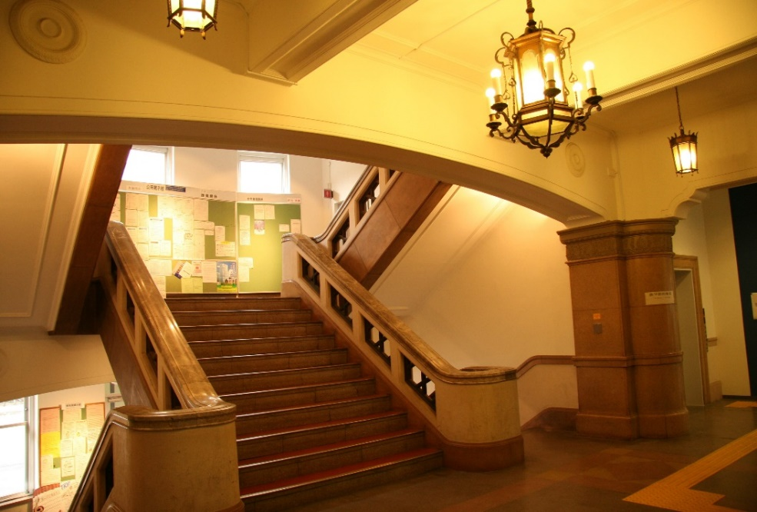
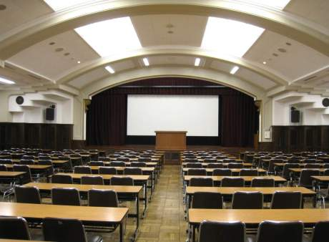
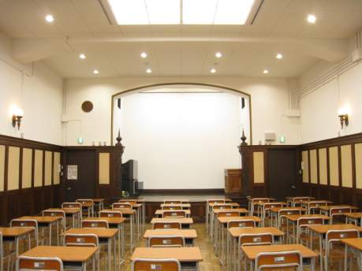
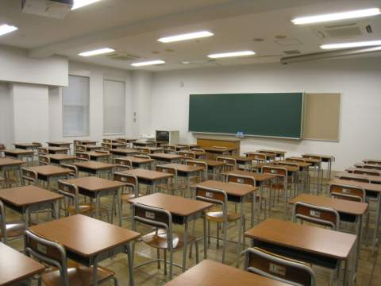
Inside the School of Agriculture
School of Agriculture Entrance Hall
Large lecture hall
Medium lecture hall
Ordinary classroom

Slide 52
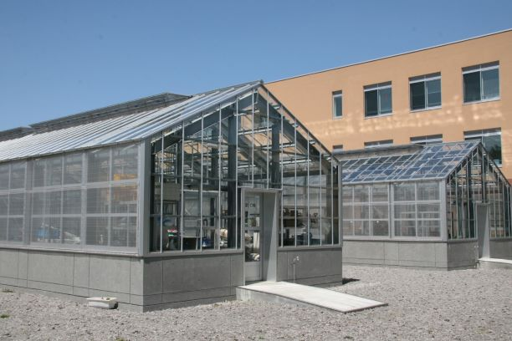
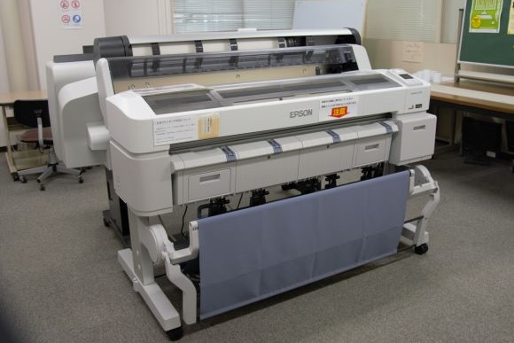
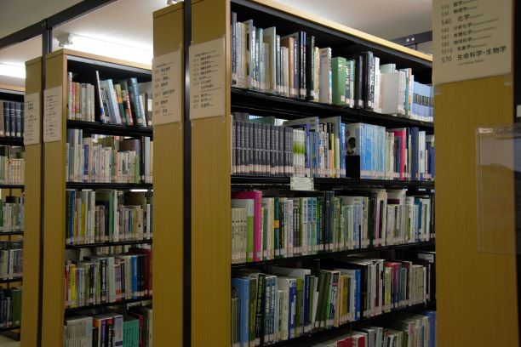
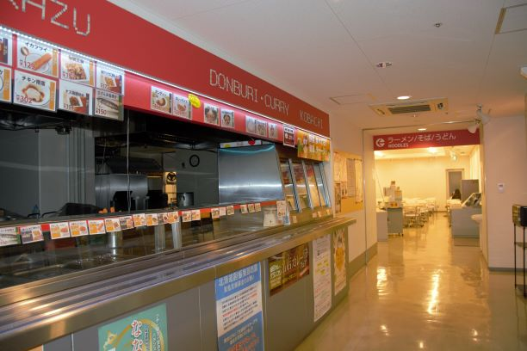
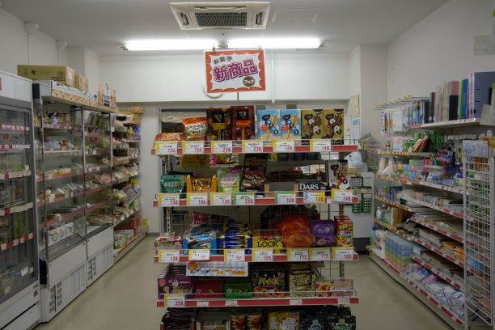
Inside the School of Agriculture
Greenhouse
IT room
Library
Hokudai Co-op School of Agriculture Branch

Slide 53
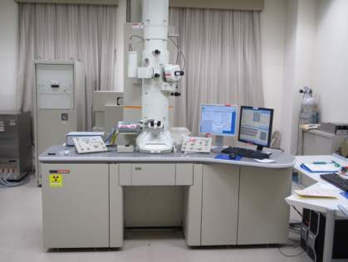
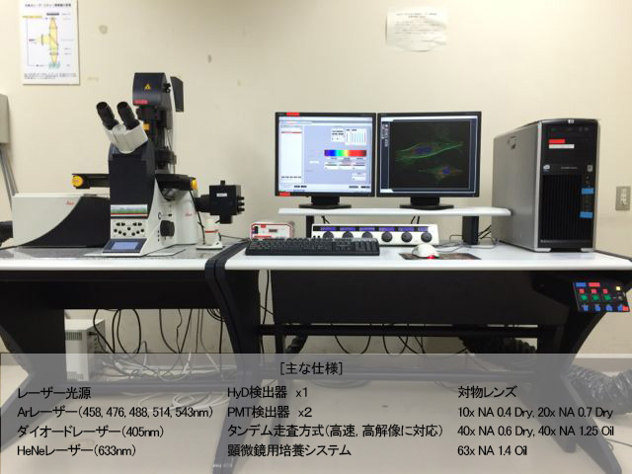
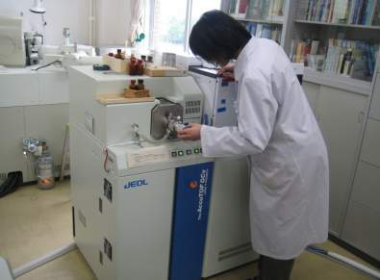

Abundant equipment and educational facilities
Confocal laser microscope
Transmission electron microscope
[Main specifications]
Laser light source HyD detector x1 Objective lens
Ar laser (458, 476, 488, 514, 543 nm) PMT detector x 2 10x NA 0.4 dry, 20x NA 0.7 dry
Diode laser (405 nm) Tandem scan method (supports high-speed, high-resolution) 40x NA 0.6 dry, 40x NA 1.25 oil
HeNe laser (633 nm) Microscope cultivation system 63x NA 1.4 oil
High-resolution
quantitative analysis equipment
500 MHz NMR

Slide 54



Facilities: Experimental Farms (Sapporo Farm / Yoichi Orchard)
Sapporo Farm
Yoichi Orchard
Sapporo Farm

Slide 55



Facilities: Experimental Farms (Sapporo Farm)

Slide 56




Facilities: Experimental Farms (Agri-Food Center)
Sausage-making practicum
Meat Processing Area

Slide 57




Facilities: Botanical Garden
Amazon water lily
Japanese wood poppy

Slide 58




Facilities: Livestock Farm (Shizunai)
Livestock Farm
Cattle barn

Slide 59




Facilities: Forest Research Station / Experimental forest

Slide 60

School of Agriculture area
Around the School of Agriculture

Slide 61





Around the School of Agriculture
Yellow star-of-Bethlehem
Central Lawn
Beer party in the School of Agriculture forecourt
School of Agriculture courtyard
Former Entomology Lab

Slide 62




Winter is severe and beautiful

Slide 63
6. Appendix

Slide 64
The School of Agriculture Now
Research Keywords
"Food“, "Environment“, "Life"
Department of Agrobiology and Bioresources
- Plant protection, crop improvement, landscape
Department of Applied Bioscience
- Genome science, molecular control, genetics
Department of Bioscience and Chemistry:
- Microbes, biochemistry, food products, environmental chemistry
Department of Forest Science:
- Forest resources, environmental protection (disasters),
forest production and processing, wood materials
Department of Animal Science
- Domestic animal management, animal product use, dairy products
Department of Bioresource and Environmental Engineering
- Environmental monitoring, land use, Bio-E
Department of Agricultural Economics
- Food logistics, farming villages, environmental costs

Slide 65
Universities are tasked with the essential work of developing science and technology while furthering invention and discovery. However, every bit of this work is ultimately done by human beings. Thus, the essential work of the university is to nurture gifted and refined students capable of making a mark on society.
From Guan Zhong's "Guanzi"
To plan for one year, plant grain.
To plan for ten years, plant trees.
To plan for a lifetime, plant people.
One grain planting grants one harvest.
One tree planting grants ten harvests.
One person planted grants a lifetime's harvests.

